Slide 1
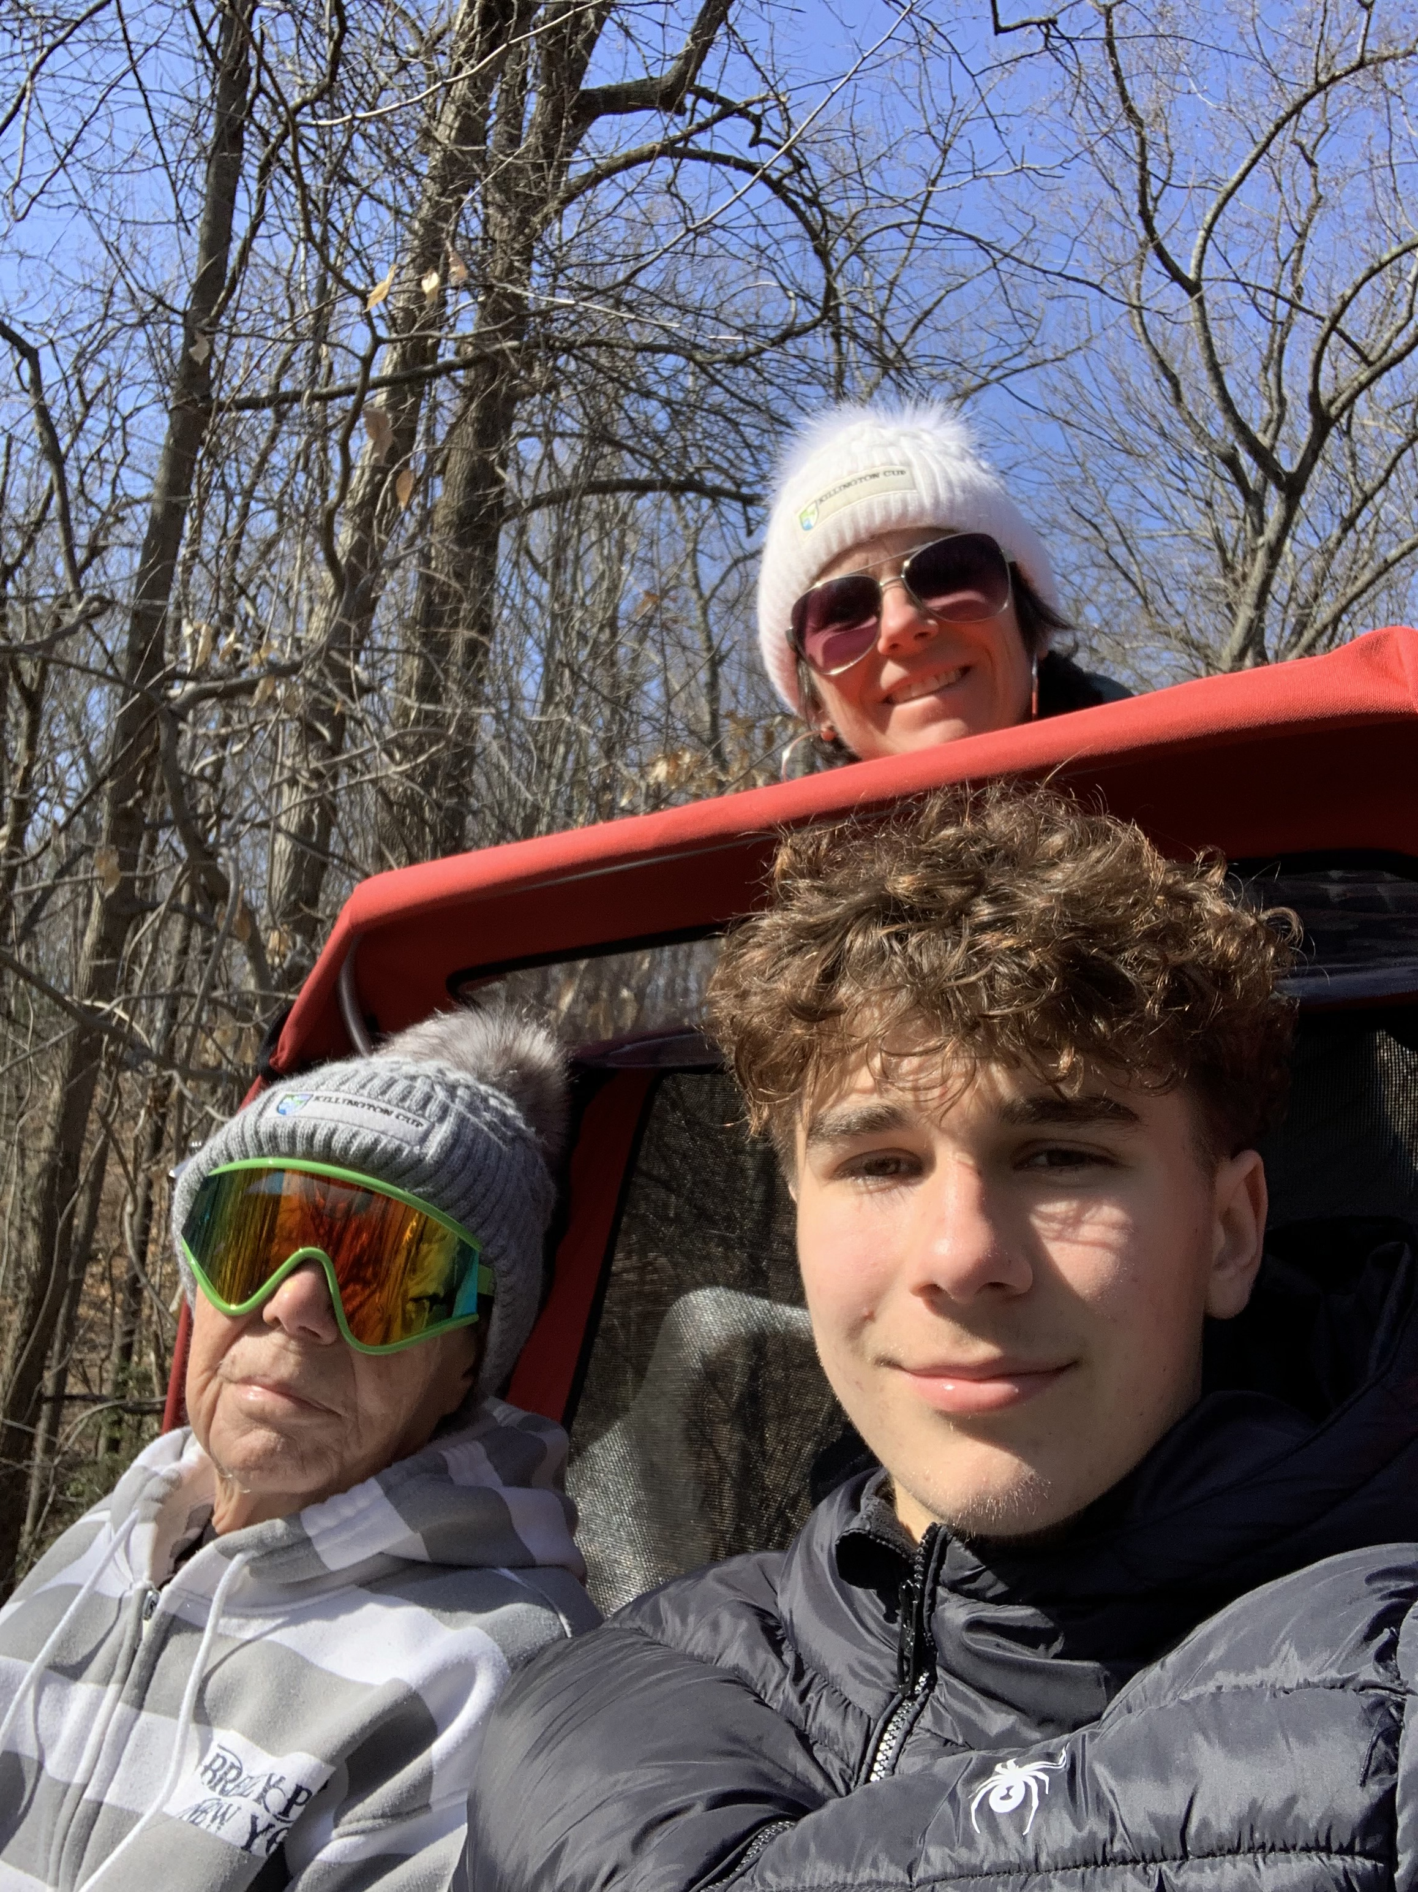



THE RIGHT TO WIND IN YOUR HAIR
Sandra Bishop
Program Manager
Cycling Without Age Anne Arundel

Slide 2
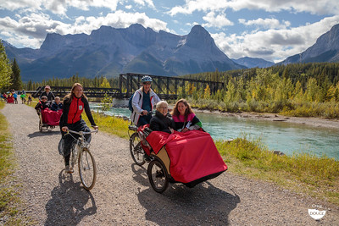
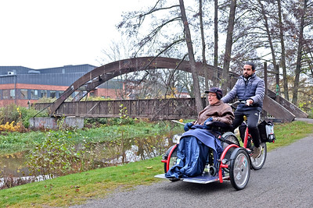
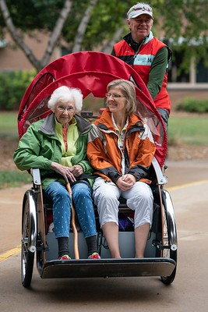
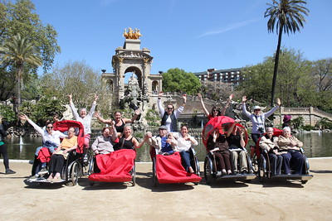
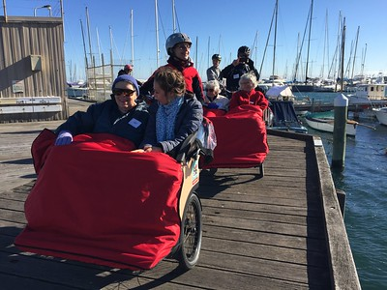
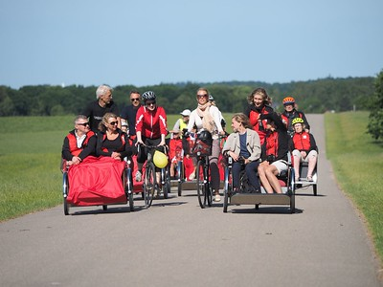
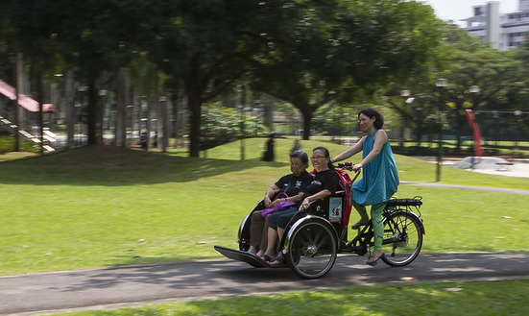
What is CYCLING WITHOUT AGE?
Canada
Sweden
Spain
Started in 2012 Denmark
Worldwide
Rides always free
Relationships
Story-telling
Sensory Stimulation
Joy
Australia
Colorado
Singapore
Denmark
Notes:
CWA is a global organization aimed at reducing social isolation and increasing both mental and physical health for the elderly.
Founded in 2012 in Copenhagen Denmark
Chapters in 39 countries (as of February 2023)
3,050 chapters internationally
chapters in the US in 25 states
Over 3 million rides and 650,000 people served

Slide 3
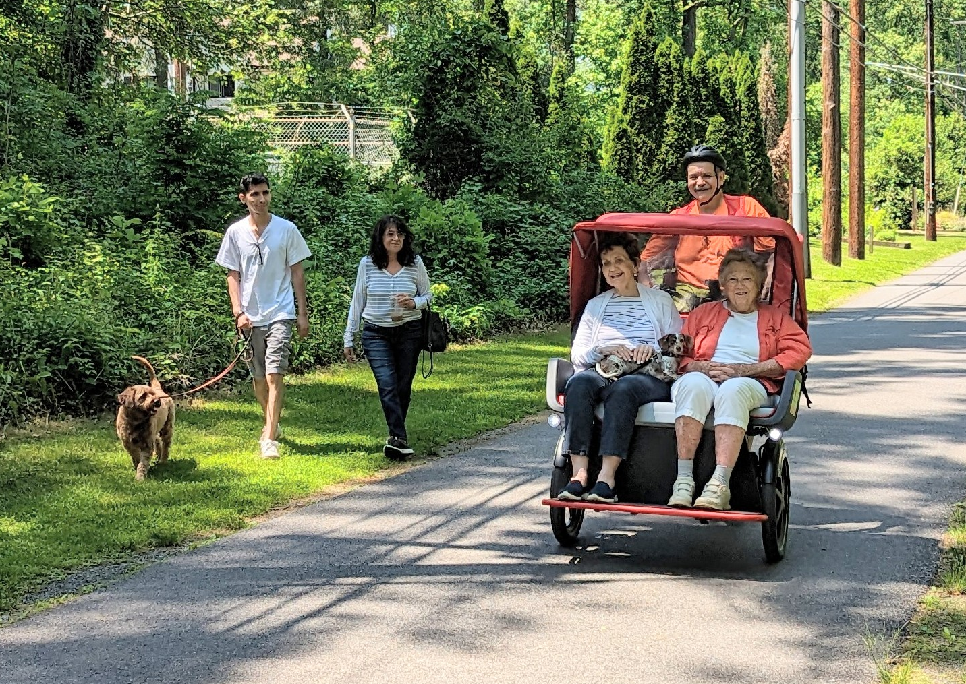
GUIDING PRINCIPLES
Generosity
Slowness
Storytelling
Relationships
Without age
Notes:
Generosity – simple acts that spread happiness
Slowness – allows time to meet people along the way and enjoy being outdoors
Storytelling – sharing stories connects people
Relationships – build trust, happiness & better quality of life (study mentioned at summit said # of incidental relationships + impact on quality & length of life
Without age – letting people age in a positive context

Slide 4
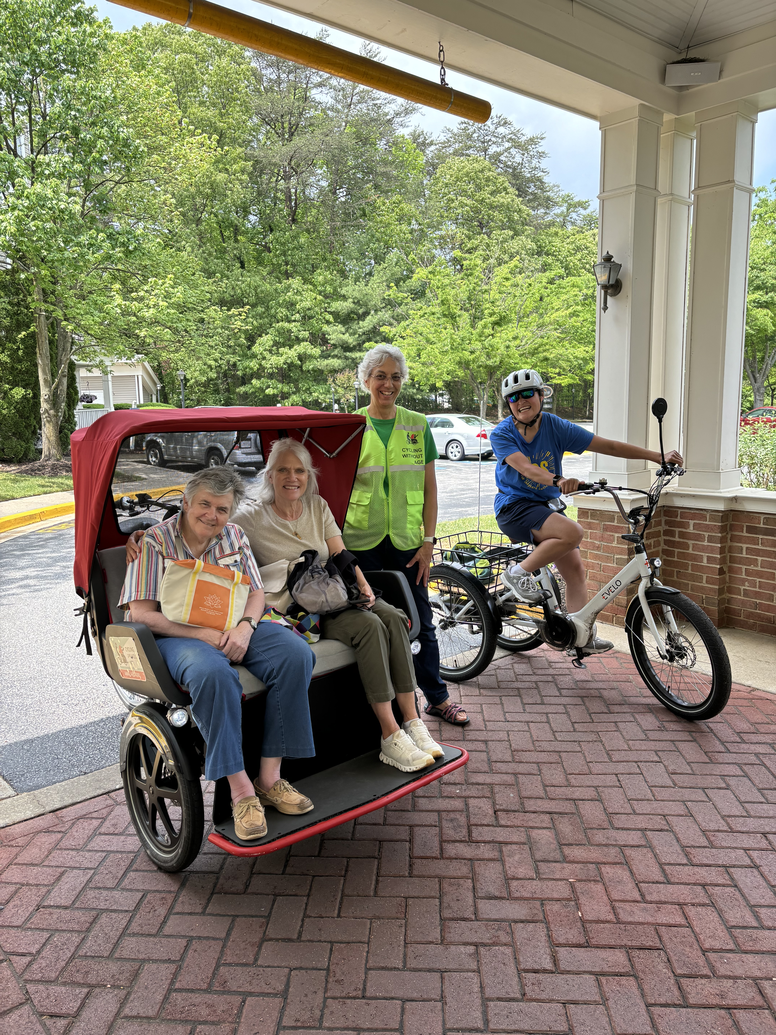
WHO BENEFITS?
Care Givers
Seniors
Volunteers
Adults & children with disabilities
Notes:
Seniors: Danish study measured happiness before/after 16-20 weeks of participation; scores went from below to above the national average. Not only are they happier during the ride, the feeling lingers long after the ride is over
Report back from activities director after a few of her residents went on a group ride (this was also the ride we had our first flat tire and tipped a passenger into a bush!) “The residents had a blast! When they got back, some other residents were saying they wish they went.. Also, everyone is okay! They had a blast! Thank you so much!”
Adults & children with disabilities can experience that same sense of “normalcy” and freedom of movement
Care home staff: Another study found staff changed their perception of residents’ abilities, rides gave them more to talk about with residents, and rides made staff happier
Volunteers & community: sense of purpose, get more from it than they are giving, and they get to engage with people they might not otherwise spend quality time with
Seniors of course, as I just described. A study published this past January found the happiness scores of seniors went from below the national average to above after 16-20 weeks of having a few rides each week. Report back from activities director after a few of her residents went on a group ride (this was also the ride we had our first flat tire and tipped a passenger into a bush!) “The residents had a blast! When they got back, some other residents were saying they wish they went.. Also, everyone is okay! They had a blast! Thank you so much!”
Rides are available to anyone with mobility limitations regardless of age.
Care givers also benefit. One study of staff found that after going for rides with their residents the staff had a new appreciation of what their residents could do, had more to talk about with them while caring for them and just generally improved their mood too.
Volunteers feel a sense of purpose, get more from it than they are giving, and they get to engage with people they might not otherwise spend quality time with

Slide 5
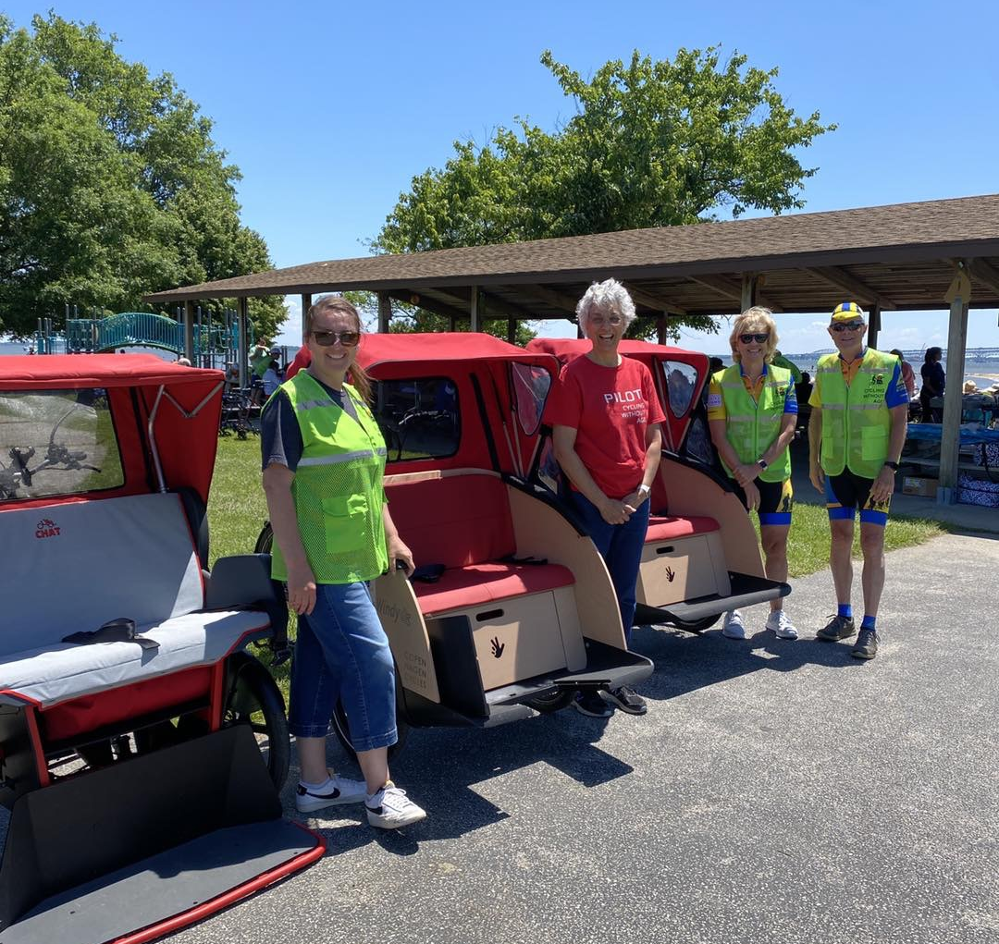
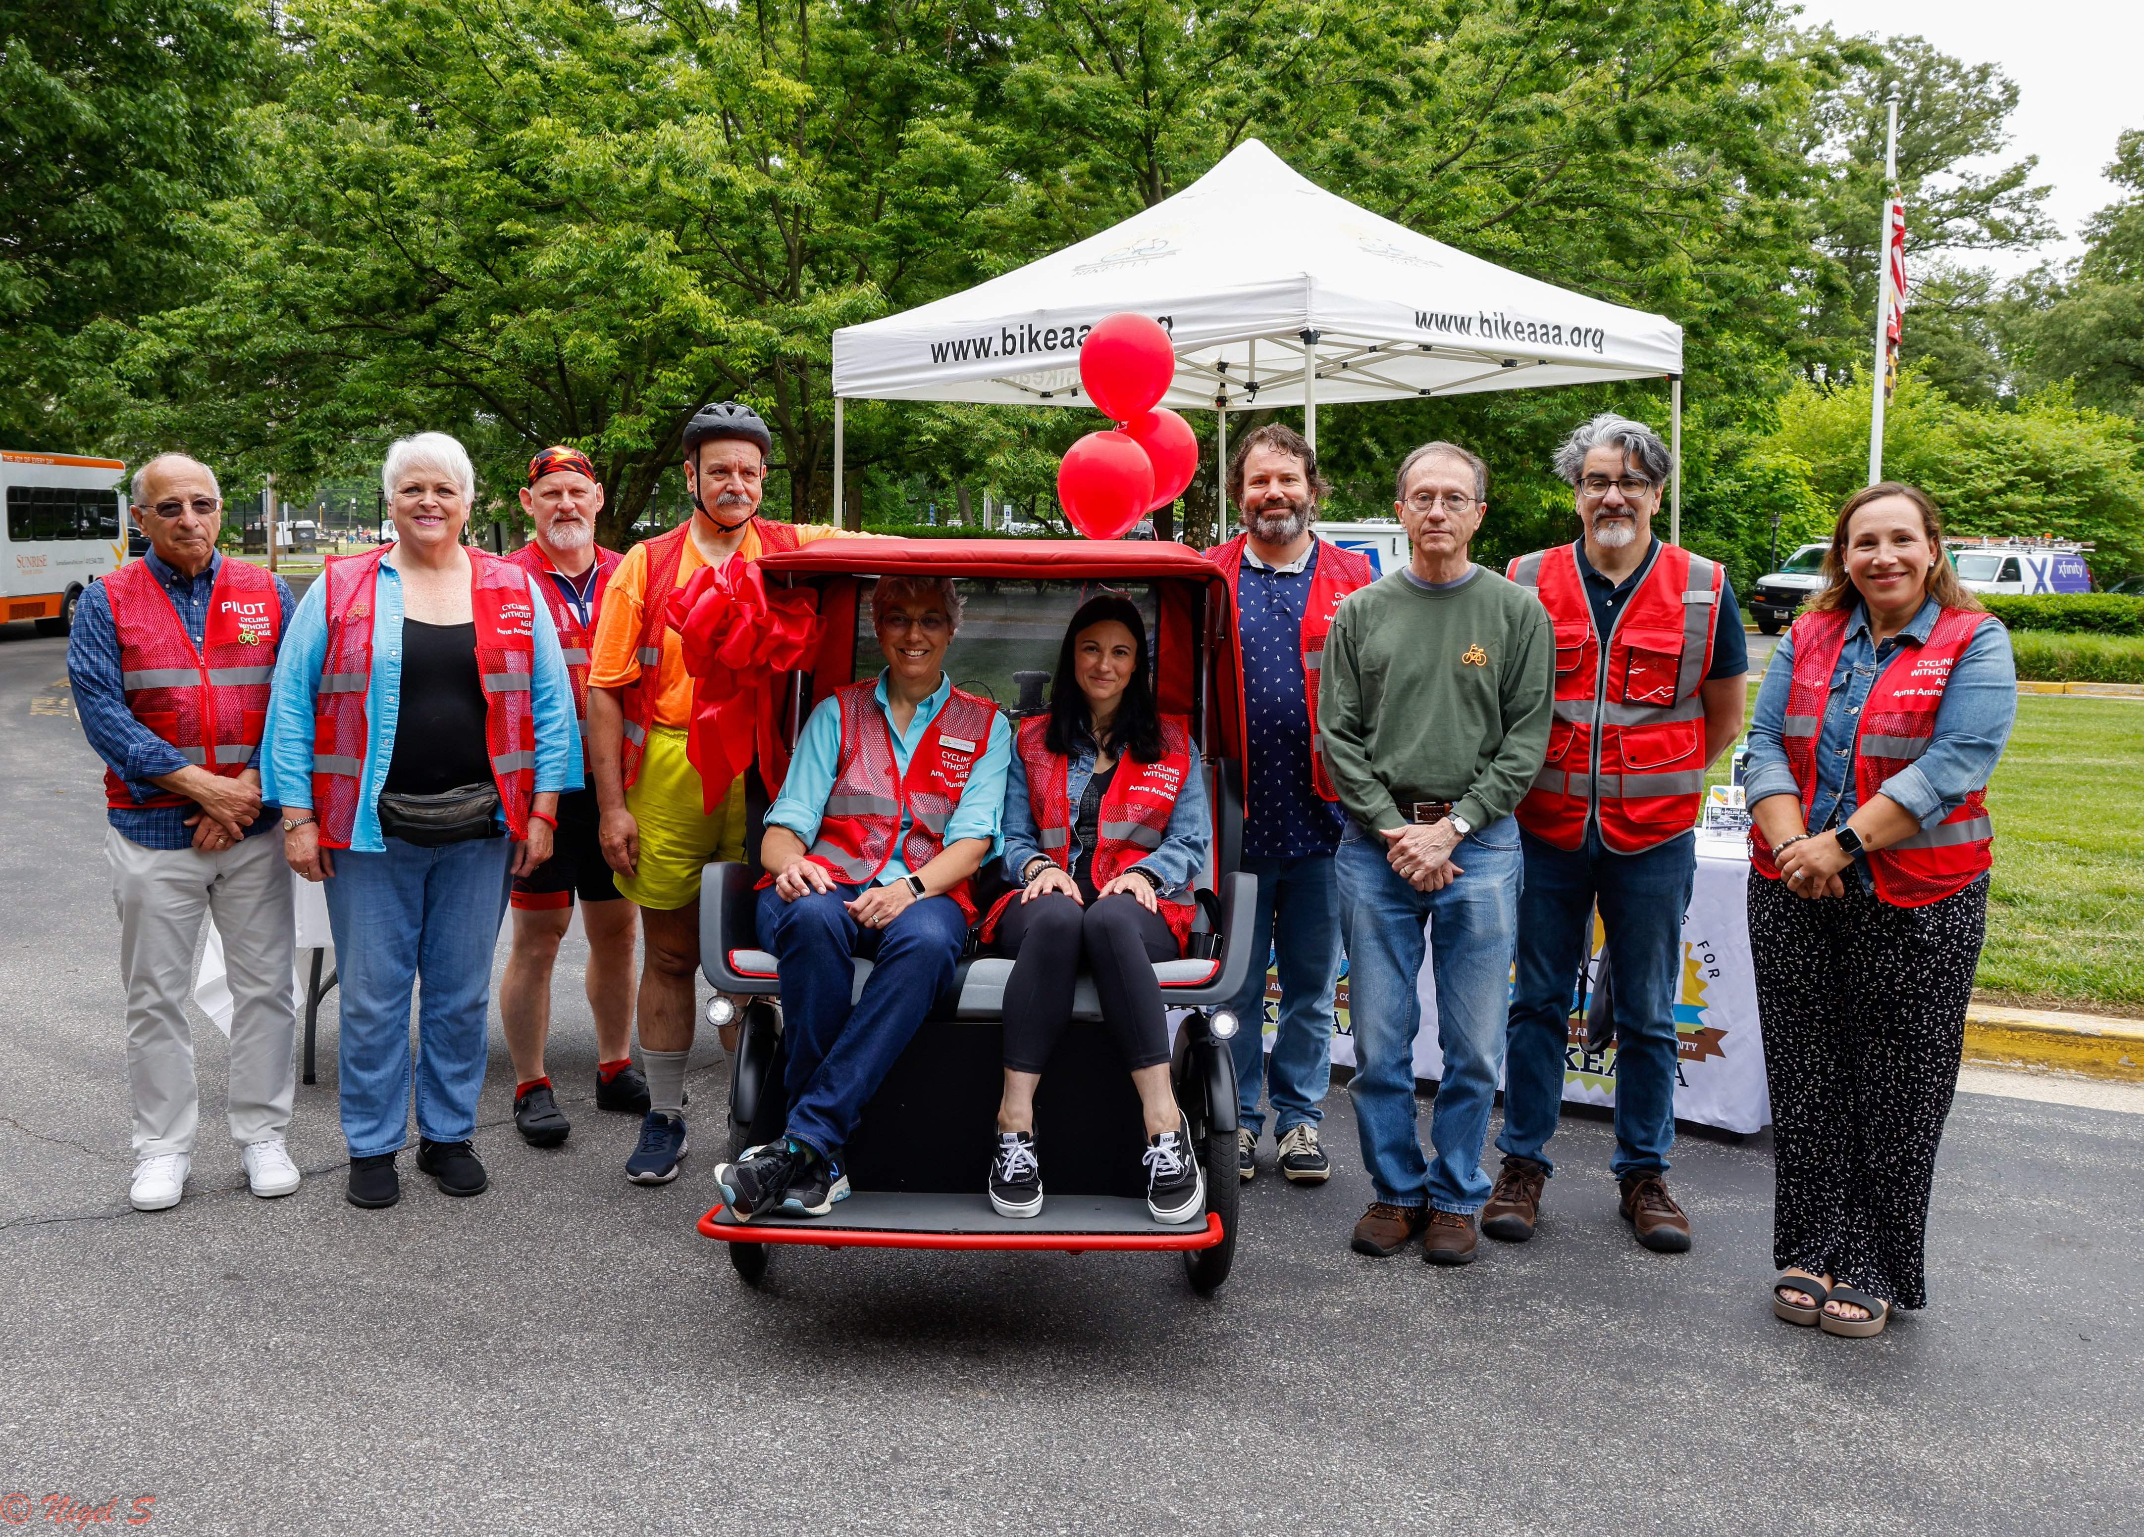
BIKE GROUPS BENEFIT
Up to 2/3 of volunteers in Anne Arundel are non-cyclists!
Notes:
CWA gives cyclists a way to share their love of cycling with the community, especially seniors. It also introduces cycling to a new group of future cycling advocates! We have a high school BMX biker, a bike race judge, cross country cyclists, triathletes, retirees, and some don’t even own a bicycle! CWA connects all these people around a common purpose and for some introduces them to cycling safety practices and the need for more and safer bike infrastructure so we can take people on these rides in more areas.

Slide 6
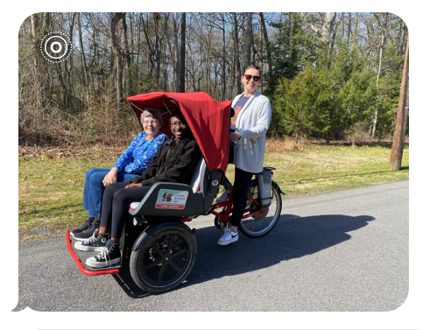
“
I just finished my first ride and it was EPIC!! …Thank you for this opportunity!!
“
Thank you so much for the opportunity to ride the trishaw and be a part of the program! …They kept thanking me, but little did they know I was the thankful one! … It was a great day and I can’t wait to go out again!
Taryn & Kirstan, after their very 1st rides
ENTHUSIASTIC VOLUNTEERS

Slide 7
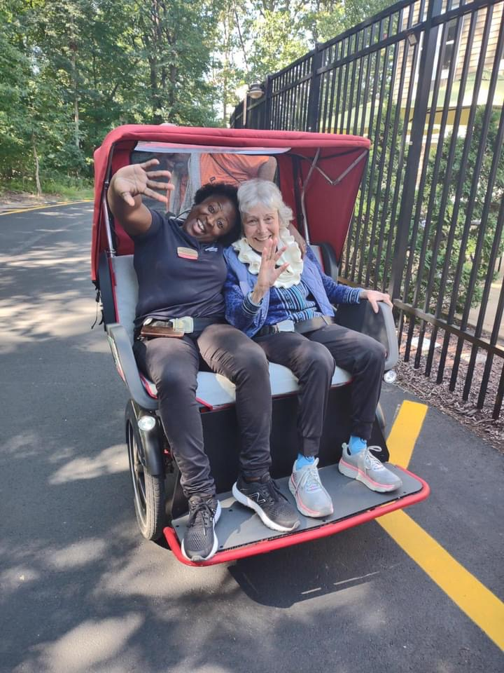
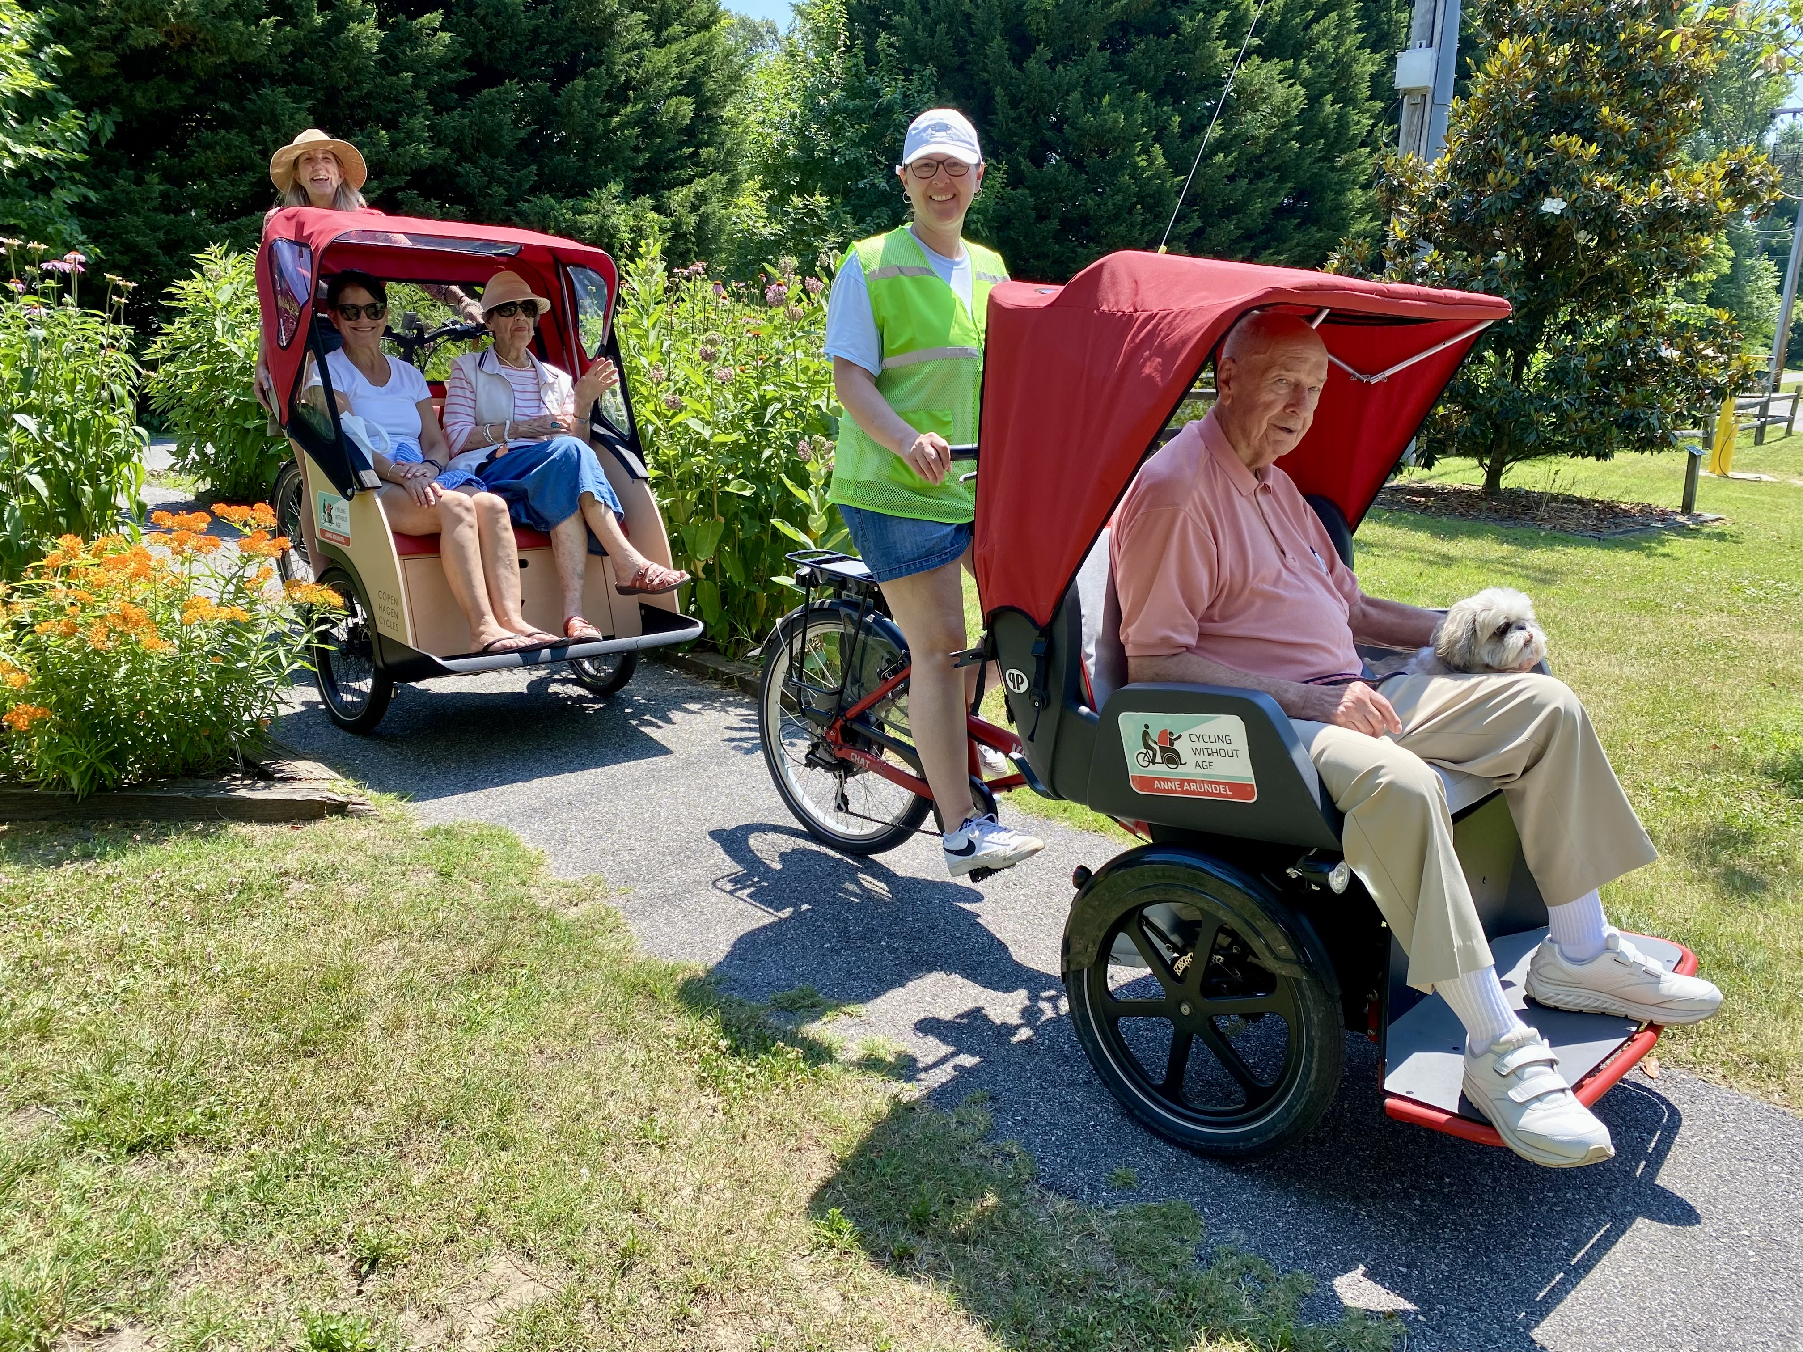
COMMUNITIES BENEFIT
CWA shows that communities are:
Livable
Connected
Walkable
Bikeable
Age-friendly
✅
✅
✅
✅
✅
Notes:
Communities are looking to be recognized as more livable, more connected, more walkable, more bikeable, more age-friendly. Cycling Without Age shows a community is interested in being all those things.

Slide 8
START
UP ELEMENTS
1st Become an affiliate cyclingwithoutage.org
Schedule System
Bikes/
storage
Ride
Location
Passengers
Pilots
$$$ Requires fundraising
Additional cost for insurance and maintenance
Bike clubs
Community volunteers
Students
Free or low-cost options
Safe & enjoyable
Easy access
Care home residents
Aging in place seniors
Disabled individuals

Slide 9
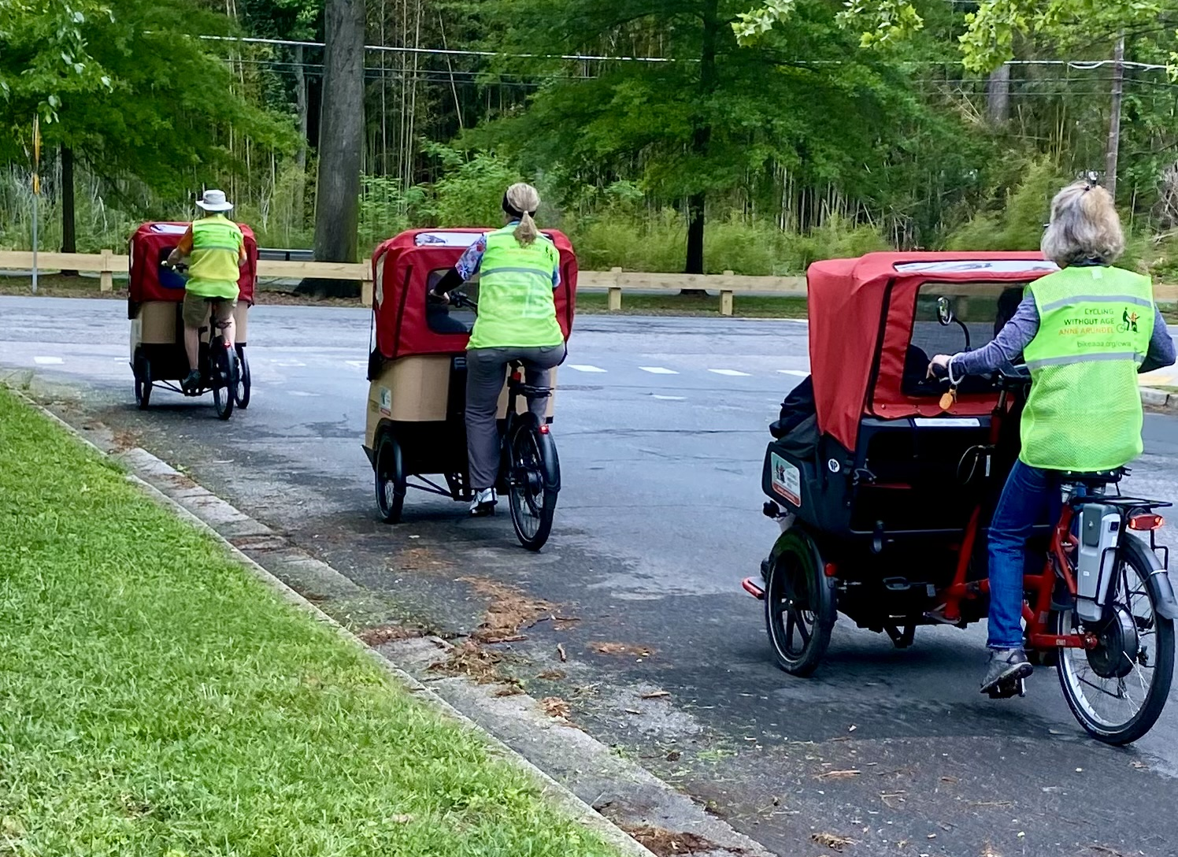
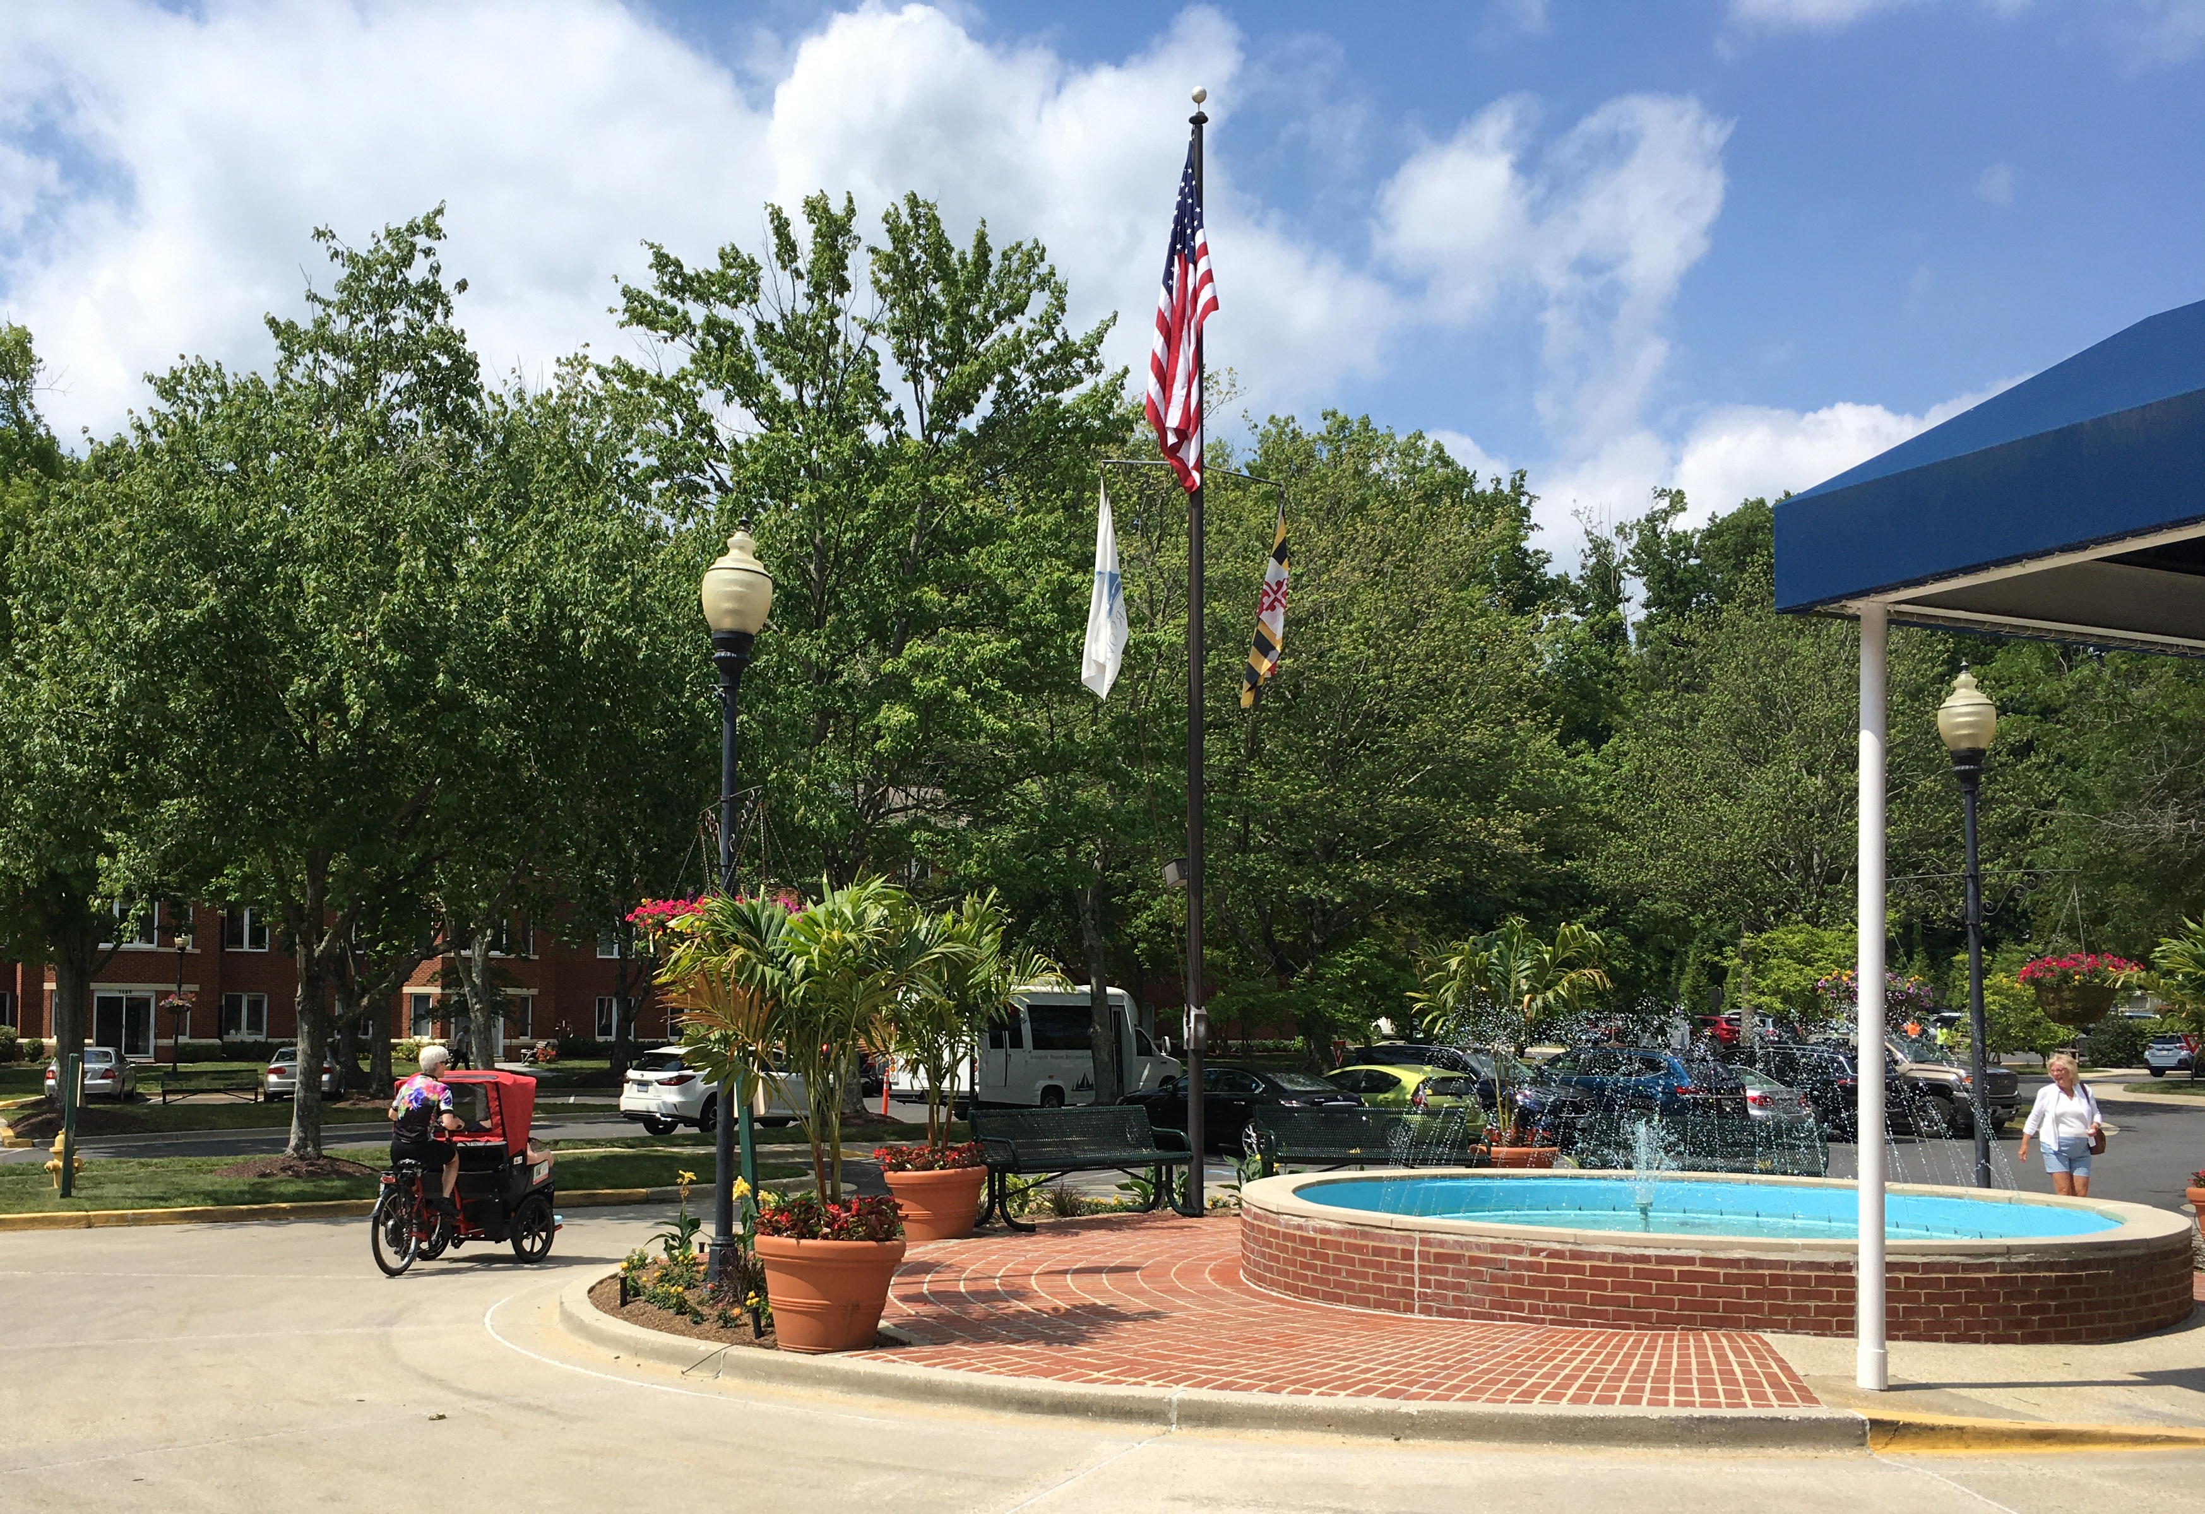


SINGLE SITE OPTIONS
Ginger Cove
Sunrise
Notes:
Single site options combine 3 of the pieces needed: ride location, bike storage, passengers. Currently in AACo we have 2 chapters of CWA. Ginger Cove is a Senior Care Facility that operates its own program and owns its own bike, providing rides to their residents around their campus and adjacent neighborhoods. My chapter, CWA Anne Arundel is sponsored by BikeAAA. BikeAAA owns the bikes & trailer and provides funding for the operational costs as needed. We have an agreement with Sunrise of Severna Park that allows us to store our equipment on their property, including charging our batteries inside their facility. In exchange, we make the program available to their residents, but we are free to also give rides to anyone in the community from that location. The benefit for them is their residents are picked up at the front door. Other facilities need to load their residents on the bus and come to our location. From Sunrise we are just 2 blocks from the B&A Trail where we do most of our rides.

Slide 10
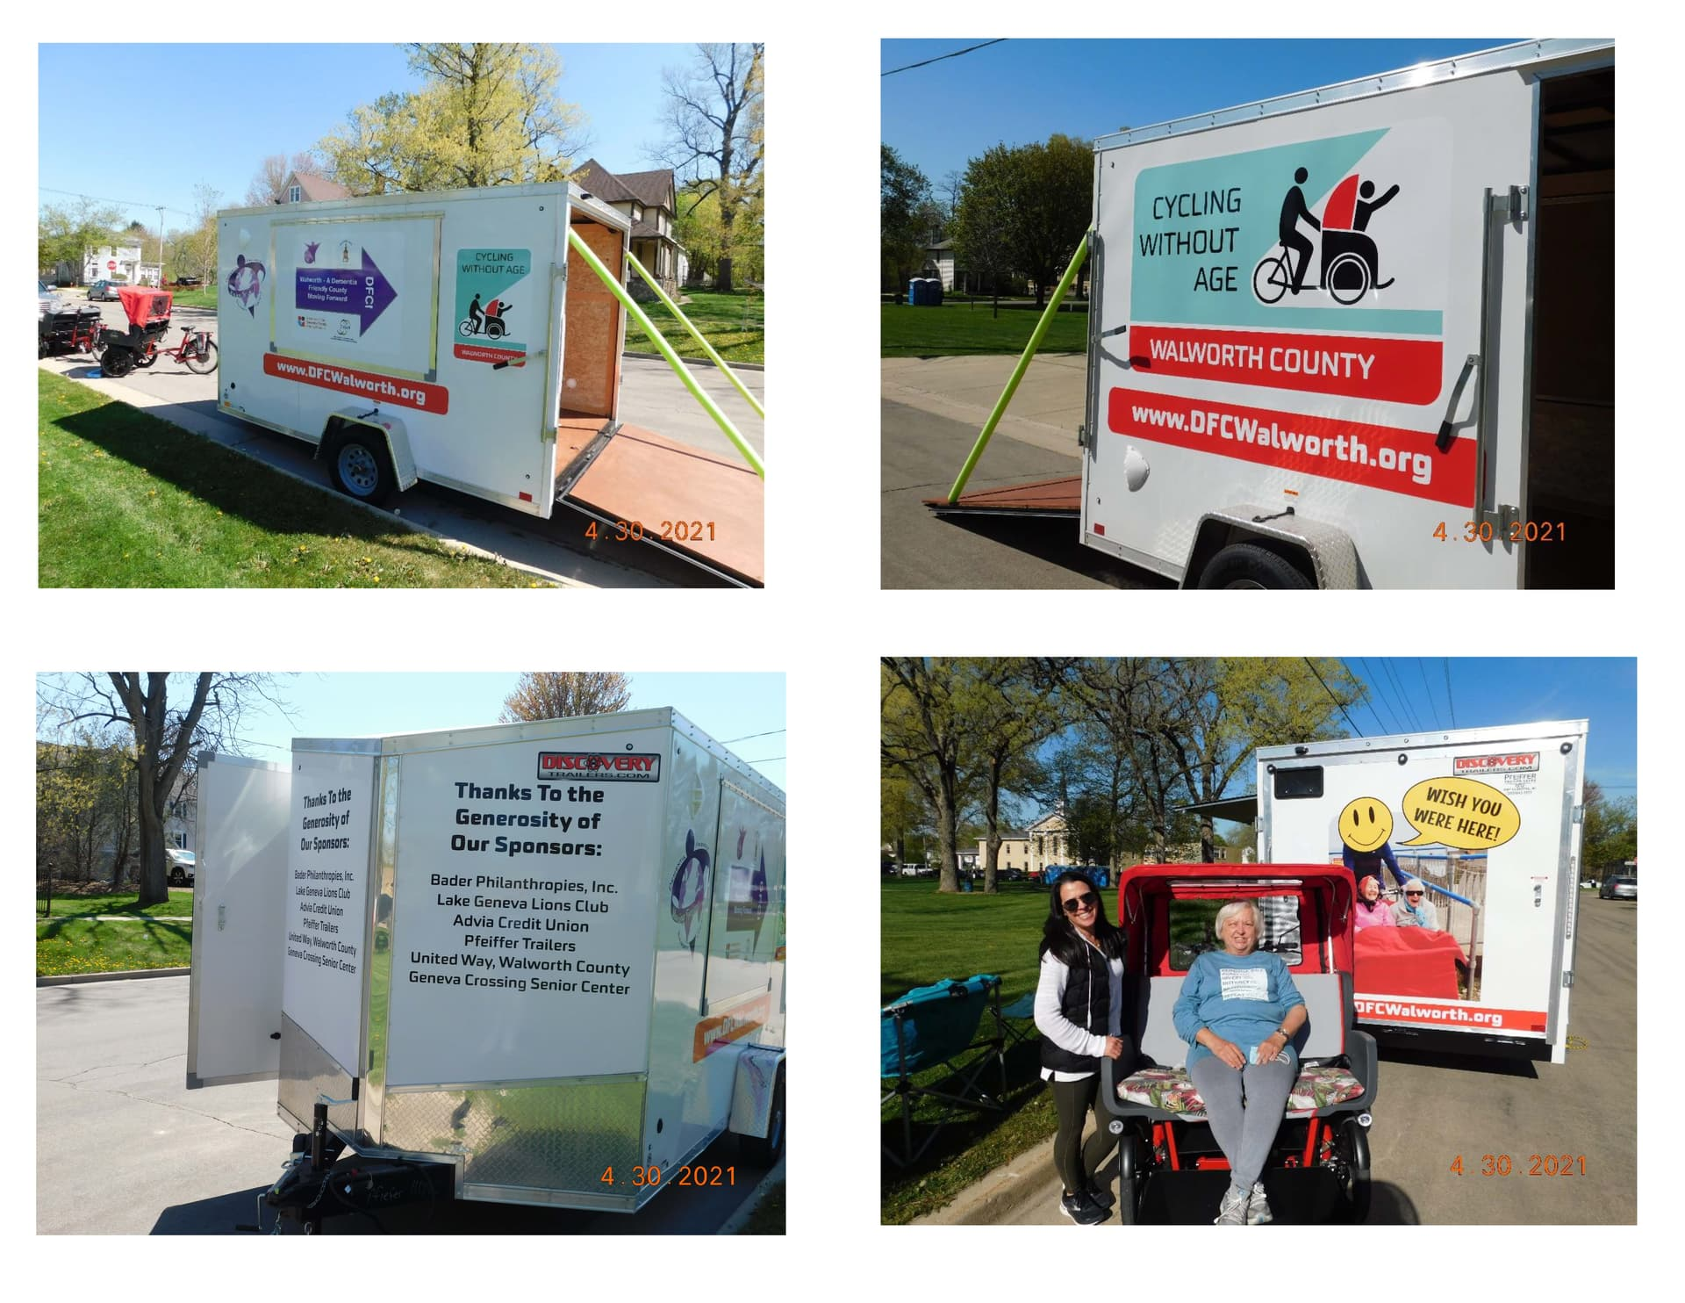
TRAVEL OPTION
Notes:
Another option used by some chapters is to trailer their bikes either to a popular ride location and have passengers meet them there or to take the bikes to the facilities where the passengers live and provide rides at that location.
Having trishaws trailered to rides adds complexity
Not all volunteers able/willing to tow trailer
Volunteers can end up spending as much time trailering as they do giving rides
Does offer opportunity to provide rides to a greater range of individuals
This particular chapter in Wisconsin gives rides at a different location each day of the week and sometimes at more than one location on a given day. It works for their situation. I just spoke to their project manager and they will give over 2000 rides this year using this model.

Slide 11
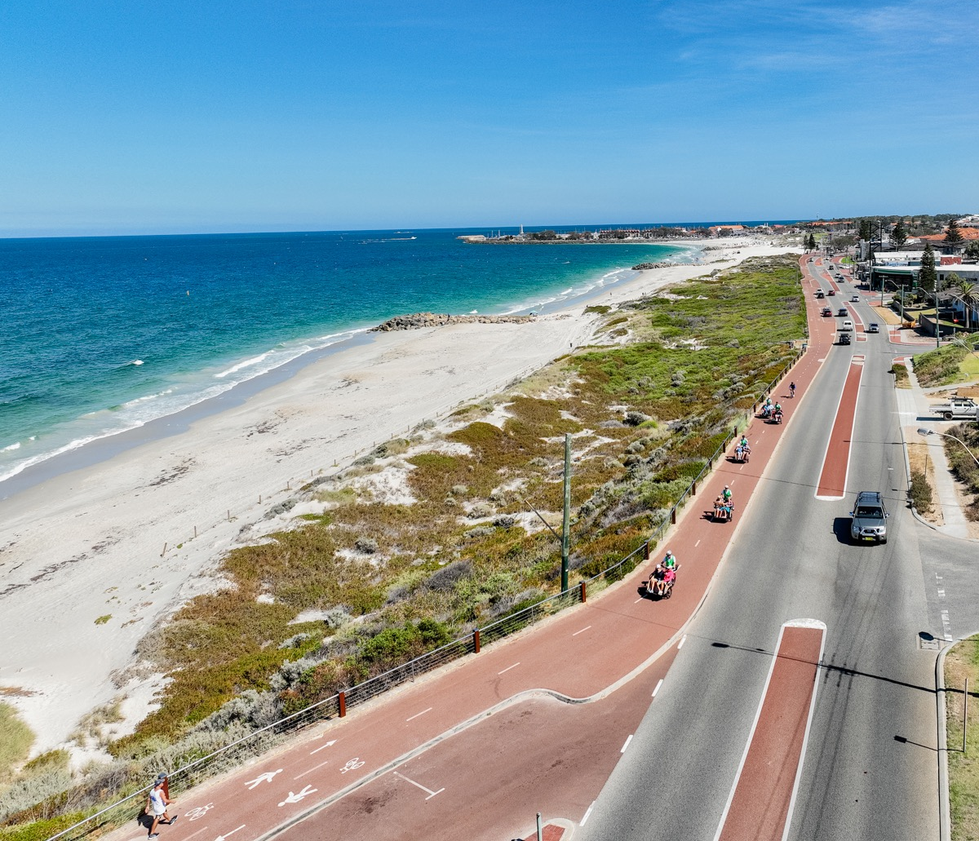
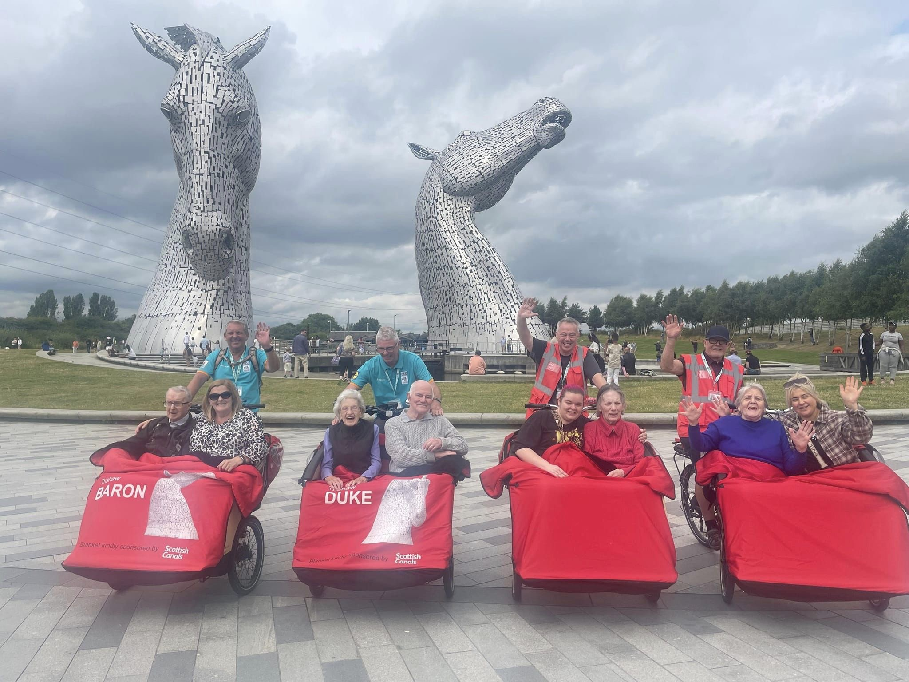
SCENIC SITE OPTION
Multiple bikes at one location allow facilities to bring a group of residents to a SAFE ride location
More expense for program
Storage/transport issues with more equipment
Australia
Scotland
Notes:
A third option which is a variation of the single site option is to have multiple bikes stored at an attractive ride location.

Slide 12
START-UP COSTS
Trishaw purchase, including shipping approx. $15,000
Insurance approx. $900 annually
  Silent Sports (McKay Group) general liability $690 annually + $.29 per volunteer ($50 for each additional trishaw)
  Equipment insurance for loss, including theft or fire (McKay Group) $237 annually for replacement cost of 1 trishaw
Maintenance budget $200 annually per trishaw
(Optional) trailer for trishaw transport & associated registration fees

Slide 13
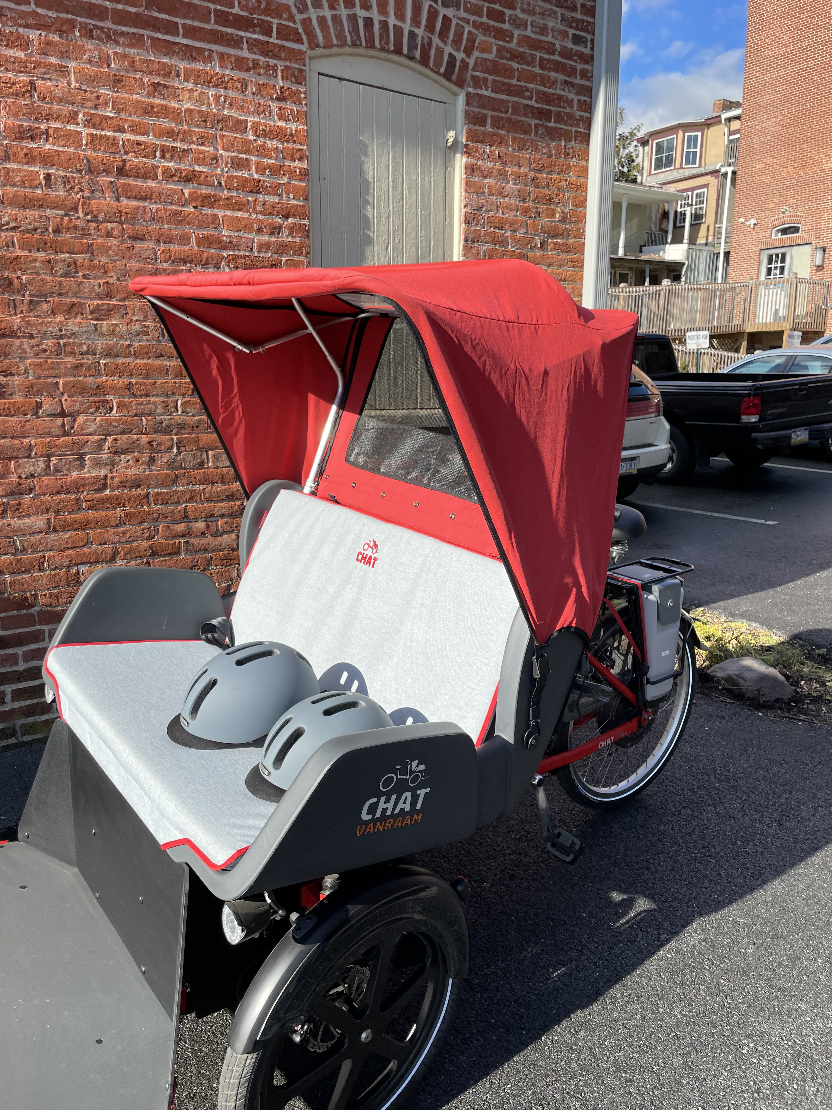

THE TRISHAW
PRICE $15,000
  copenhagencycles.com
Notes:
Copenhagen Cycles was set up to make trishaws available worldwide. Profits are used to support programs in the areas where funding is more difficult to get, especially locations with higher incidents of poverty and low-income communities.

Slide 14
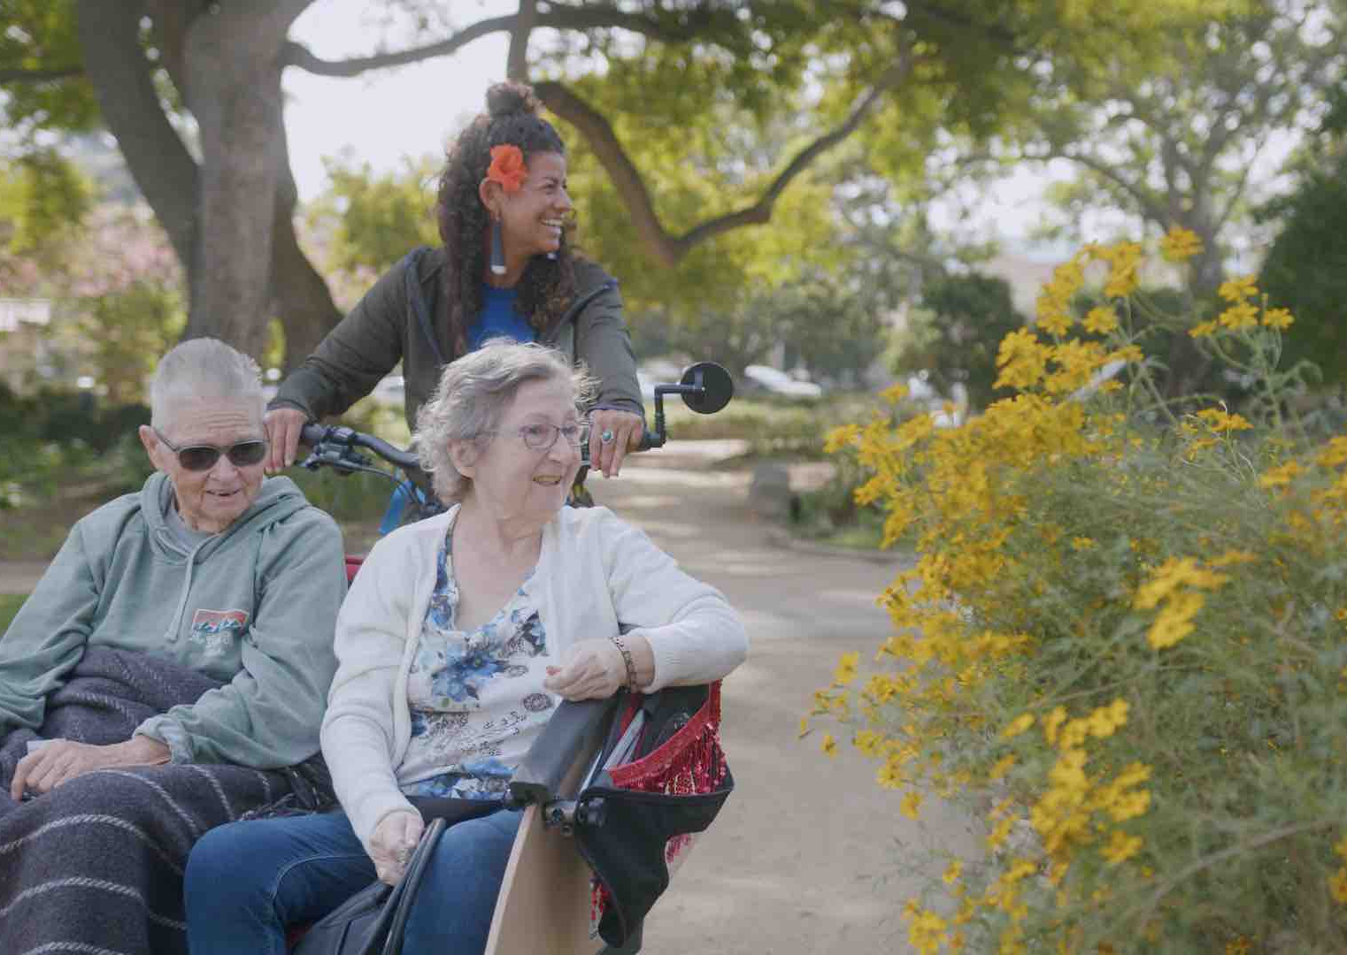
THE MOVIE
cyclingwithoutagethemovie.com
Filmed and produced in Santa Barbara, CA
Available to anyone looking to
  grow Cycling Without Age
  support existing chapters
  spark the creation of new chapters
Notes:
John Seigel Boettner

Slide 15
POTENTIAL EXPANSION SITES
Baltimore County
  Catherine Witt-Buccheri, 410-412-4044, catherine.buccheri@gmail.com
Columbia
  Juan Albertorio, juan@social-connection.org
Easton
  Heather Grant/Talbot Thrive, 410-591-6092, web@talbotthrive.org
Chestertown
  Owen Bailey, 410-810-4864, obailey@eslc.org
Friends House (Sandy Spring)
  Kadine Mitchell, 301-924-7511, kmitchell@friendshouse.com
Frederick
  Shayne Boucher, shayne@bikefrederick.org
Notes:
Also, interest in Reston, VA

Slide 16
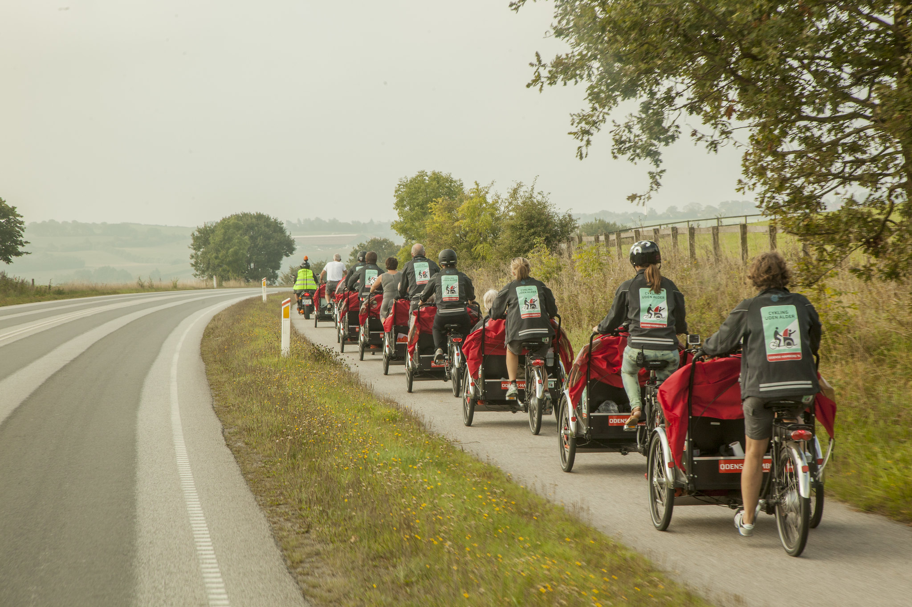
QUESTIONS?
CWA@BikeAAA.org
Photo from 2014 trip
from Odense, Denmark
to Hamburg, Germany
with 20 elderly passengers.

