Slide 1
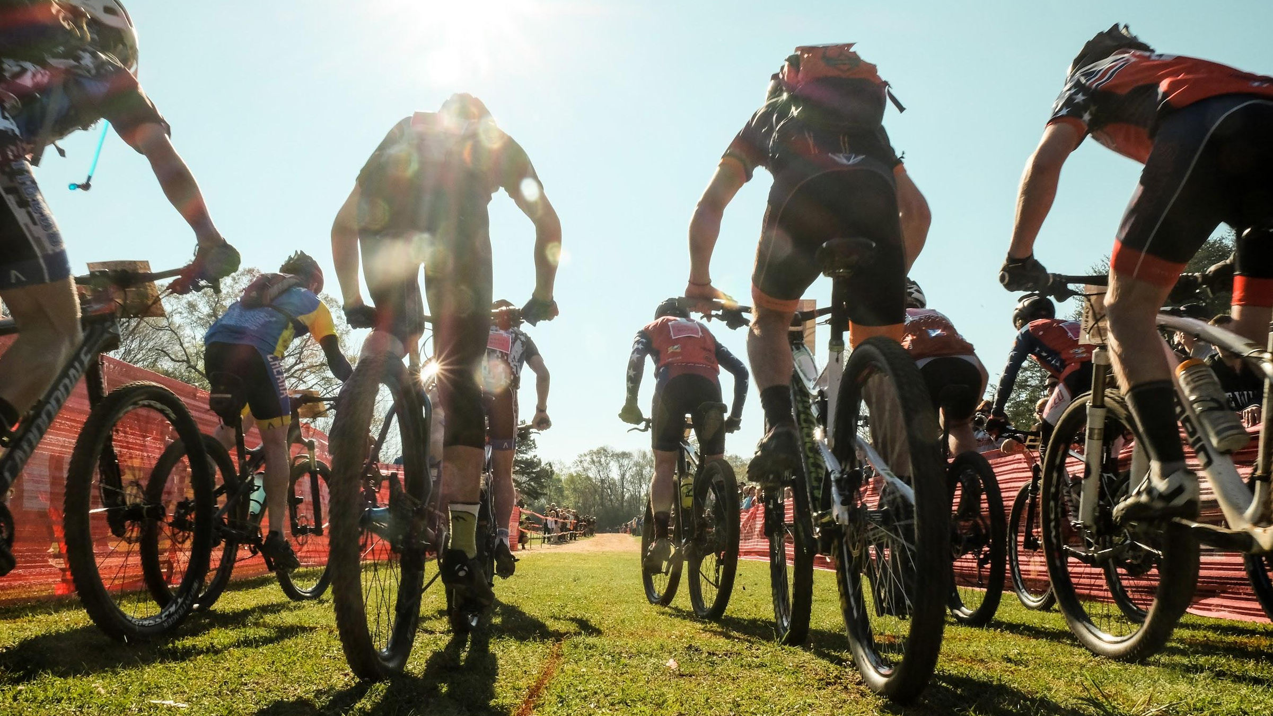
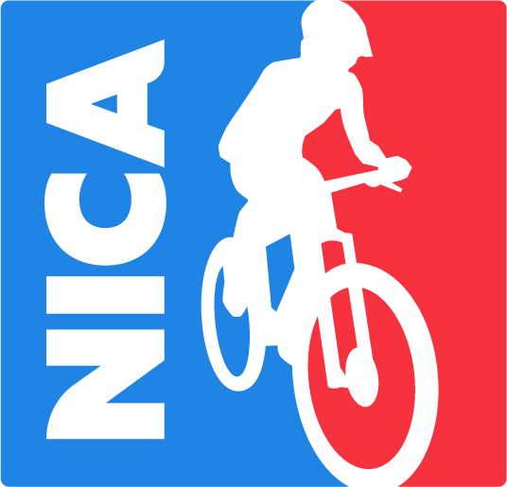
National Interscholastic Cycling Association
Proposal for 2018 Partnership with Otter Box
National Interscholastic Cycling Association in MD #MoreKidsOnBikes #MDkidsonbikes

Slide 2
(mini)Dirt Tour
The “dirt” on NICA, the MD league,
teams and coaching

Slide 3
What is NICA?
The National Interscholastic Cycling Association (NICA)
A youth development organization
Promotes mountain bike racing for grades 6-12
Formed in 2009
Now 22 leagues in 21 states
15,000 student-athletes in 2017
6,290 coaches and 10,000 volunteers!
www.nationalmtb.org
Notes:
NICA has been around since 2009, when it was originally established in northern California. NICA’s sole purpose is to develop mountain biking as an interscholastic club sport for high school students in every state, and it’s been wildly successful to date.
NICA is backed by industry players such as [pick a handful to rattle off]:
Trek
Specialized
Clif Bar
Easton
SRAM
Giro
Cannondale
Yakima
Fox
Camelbak
Gu
Industry partners include:
IMBA
Training Peaks
People For Bikes

Slide 4
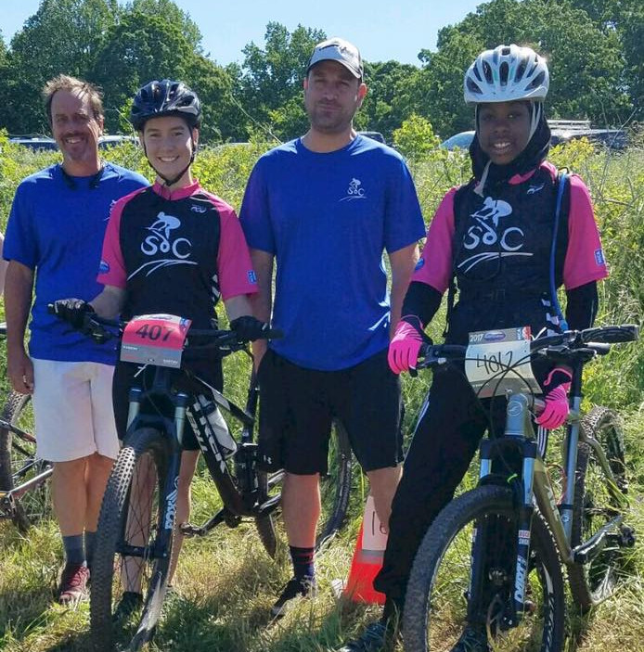
Guided by 5 Core Values
NICA is a character building organization
Inclusive
Equal
Strong Body
Strong Mind
Strong Character
PRO TIP: One-third of NICA student-athletes reported an improvement in GPA as a result of league participation.
Notes:
NICA’s purpose is not to produce the next world champion mountain biker; instead it’s an inclusive, equal opportunity program that uses mountain biking to develop character :
Build self-esteem – As student-athletes improve their skills and achieve their goals, their self-esteem and sense of self-worth grows
Help kids make better and healthier lifestyle choices (select a few)
Regular exercise
Healthy eating habits
Smart decisions regarding drug and alcohol use
Greater sense of obligation to schoolwork and community involvement
Develop important life skills – mountain biking requires a broad range of physical and mental skills, such as:
Agility
Balance
Determination
Focus
Upper and lower body strength
Cardiovascular fitness
Strong mind
Critical thinking
Decision-making
Build self-reliance, confidence and problem-solving skills -- learning how to maintain a bike, fix a flat or a broken chain gives kids
Get kids outdoors, away from screens, and provide them with the opportunity to interact with the natural world
Who doesn’t want all of those things for their kids?

Slide 5
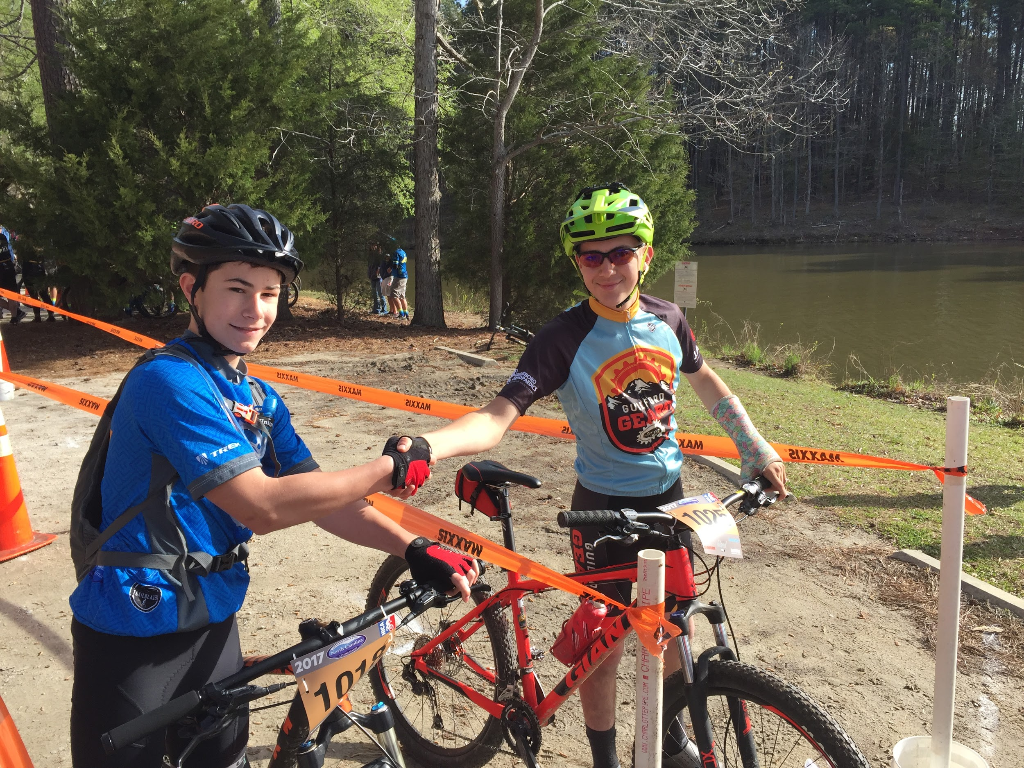
A different sport
Interscholastic mountain biking is:
A team sport - you are part of a group - no cuts, no bench, everyone rides
An individual sport - only you can turn the pedals
Community building and character building with shared experiences
PRO TIP: Mountain biking gives kids who might not be interested in a “mainstream” sport the opportunity to participate in an activity that emphasizes personal growth and life lessons.
Notes:
Mountain biking is a team sport – kids are an integral part of the team – they’re coached, they support their teammates, they represent their school or community, but it’s also an individual sport, where a key goal is to become a better, stronger student-athlete. And in a NICA league, everyone rides and everyone scores.
Cycling is also one of the few sports that they can participate in that can be enjoyed – and that can continue to provide benefits – over a lifetime.

Slide 6
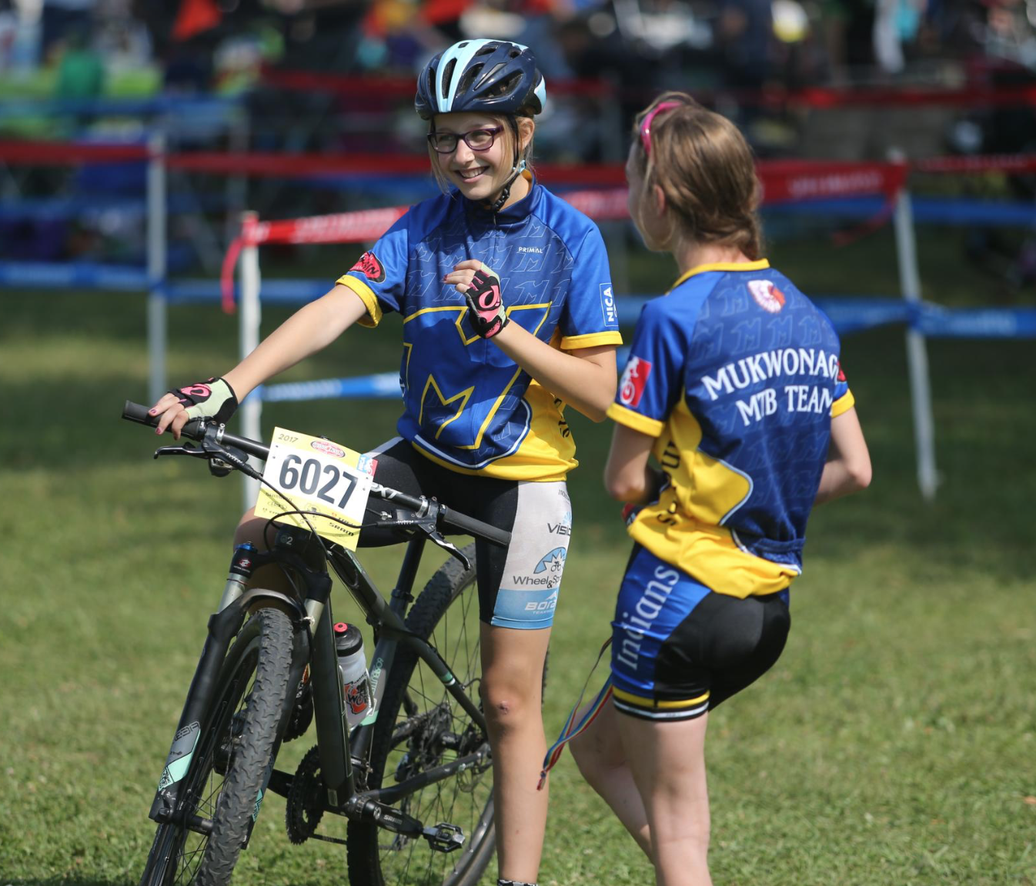
But is it safe???
Risk Management is PARAMOUNT in NICA programming
Safety governs all activities
Risk Management training is required for every adult volunteer
“Ride with respect” theme runs through every league
Lower rate of injury than any other interscholastic sport due to strong risk management practices
Low impact - limited ROM
PRO TIP: NICA’s current safety study is the largest injury surveillance program of its kind in the country with more than 250 teams reporting weekly!
Notes:
Cycling is also one of the few sports that they can participate in that can be enjoyed – and that can continue to provide benefits – over a lifetime.

Slide 7
Key NICA facts
97%
of student-athlete participants come back
73%
report that their participation inspired others to start riding
67%
growth in girls’ participation in NICA
88%
of NICA student-athletes report improved fitness as a result of participation
85%
of student-athletes will continue on to a 4-year college or university
78%
Of student-athletes report increased respect for the environment
Source: NICA 2014 Annual Report; available at www.nationalmtb.org
Notes:
NICA is working…
It’s working for the student-athletes’ education and health, their families and friends, the environment, and for getting girls involved

Slide 8
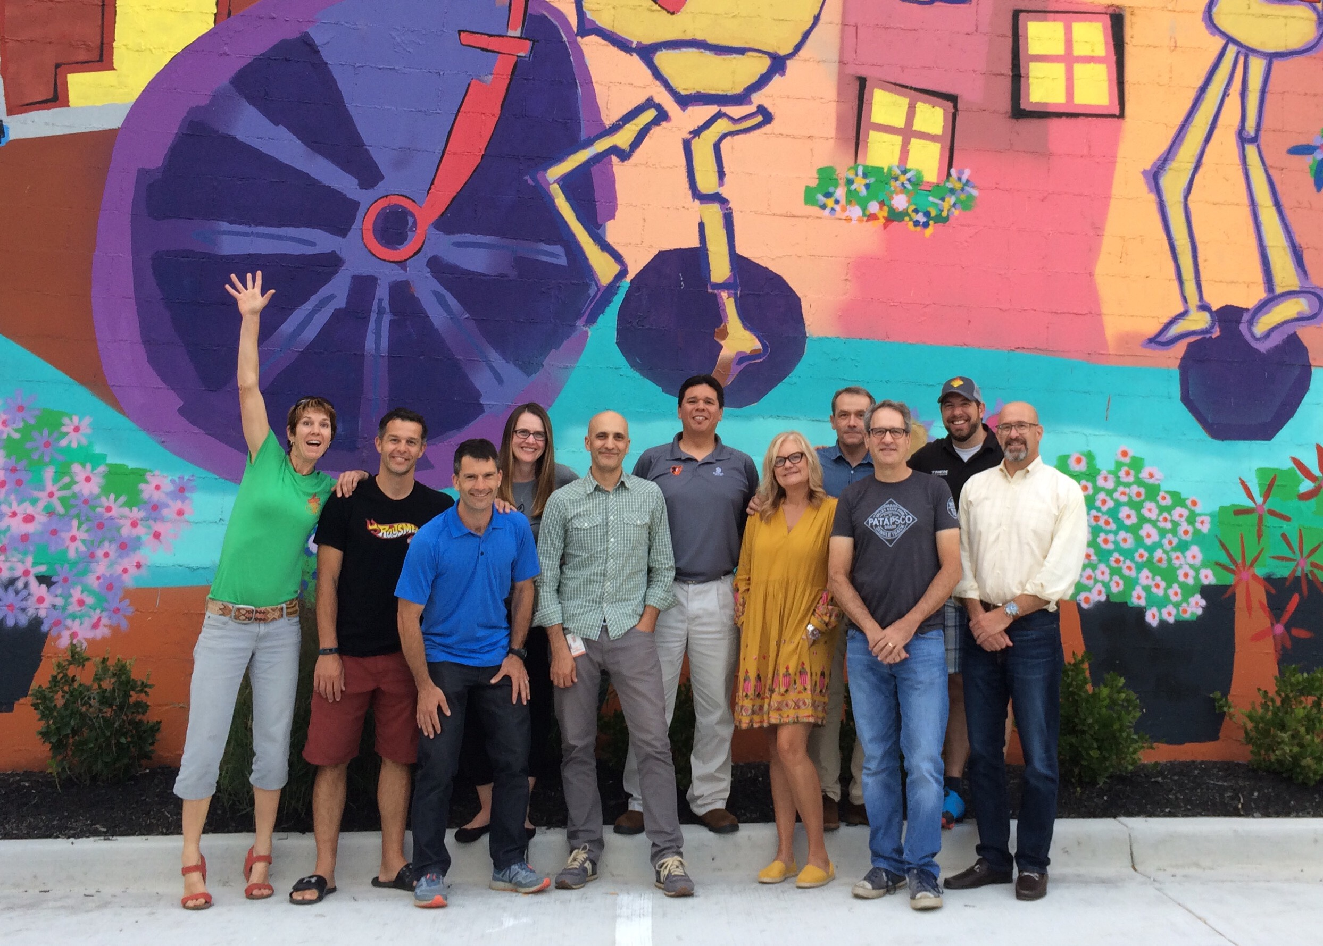
NICA in MARYLAND!

Slide 9
Our Mission
To enable every Maryland teen to develop a strong mind, a strong body and strong character through lifelong participation in cycling. The Maryland Interscholastic Cycling League:
Fills a niche for students whose needs aren’t met by traditional school sports
Gets kids outside
Welcomes & supports all types of diversity
Promotes trail maintenance & stewardship
Improves focus and academics
Promotes health & fitness in teens and their families

Slide 10
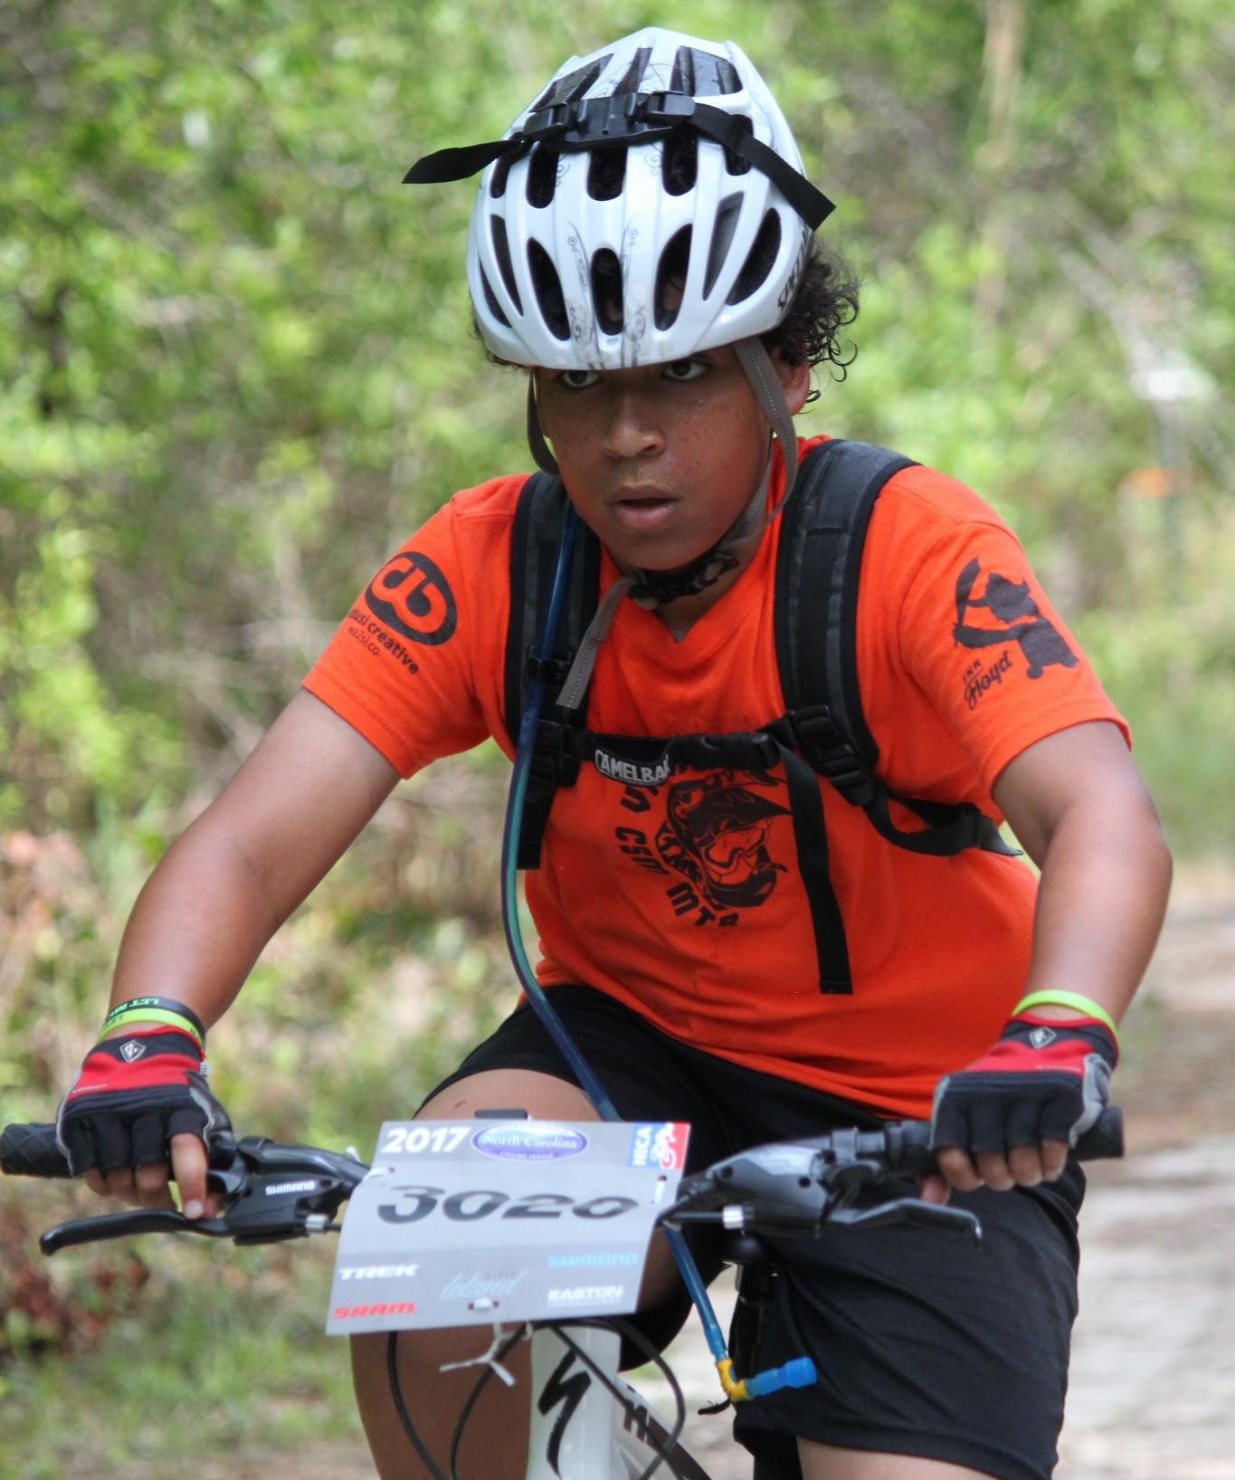
More kids on bikes
Our focus is on youth development
There are no team tryouts or team cuts
Student-athletes are encouraged -- but not required -- to race
Every score counts in team results
Non-racing team members may still participate in practices, team rides and other events
PRO TIP: There are many roles that team members can play, such as mechanic, team manager, photographer, race-day support, etc.

Slide 11
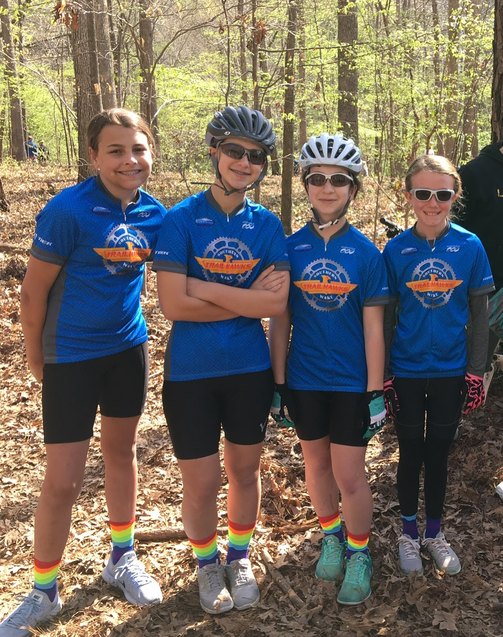
NICA GRiT Outreach Program
The GRiT program inspires young women to build confidence and empowerment through off-road cycling.
GRiT is for:
All girls who participate in the League
All women who volunteer for the League as coaches, ride leaders, or other roles
All women who support getting more girls on bikes and are committed to helping increase numbers of girls participating in the Maryland Interscholastic Cycling League!
PRO TIP: Nationally, under 22% of NICA student-athletes are girls. That’s a good start, but we want MD to raise this average!

Slide 12
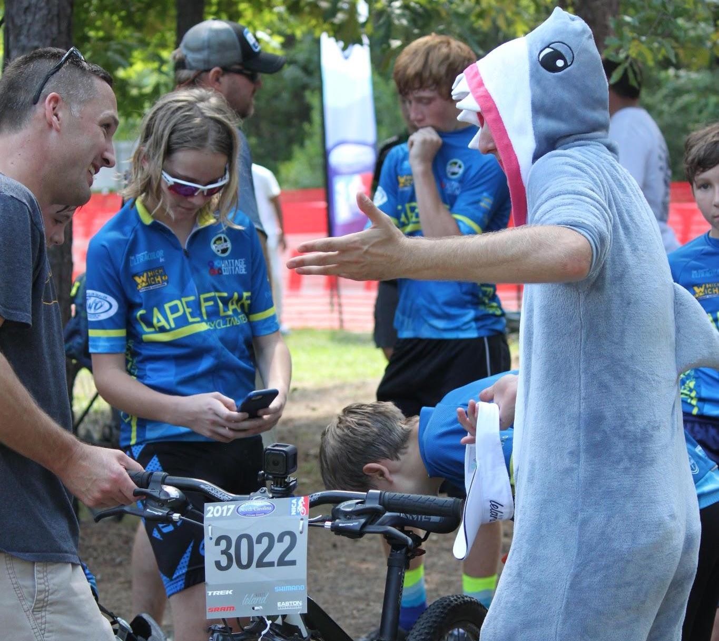
You can do this!
No prior coaching experience is necessary
You don’t need to be a great rider
NICA and the MD League will provide the training and guidance you’ll need
Risk management
Coaching and skills training
Starting a team
Videos, presentations, checklists, contacts
Coaching a team can WILL be one of the most rewarding experiences of your life
(you might end up at a bike event wearing a shark suit)
PRO TIP: There are thousands of NICA coaches that have gone through the process of starting a team – they’re a great resource!
Notes:
The MD League and the NICA team is here to help you through every step of the process.
Training is available year-round and include a variety of mechanisms
Online webinars
In-person training
Manuals and documentation
Resources include:
Starter kits, with step-by-step instructions to start your team
Online webinars
Coaching and skills training manuals
Videos
Presentations
Checklists
Mentors
Annual Leaders’ Summits – one-stop-shopping option for obtaining your coaching certification

Slide 13
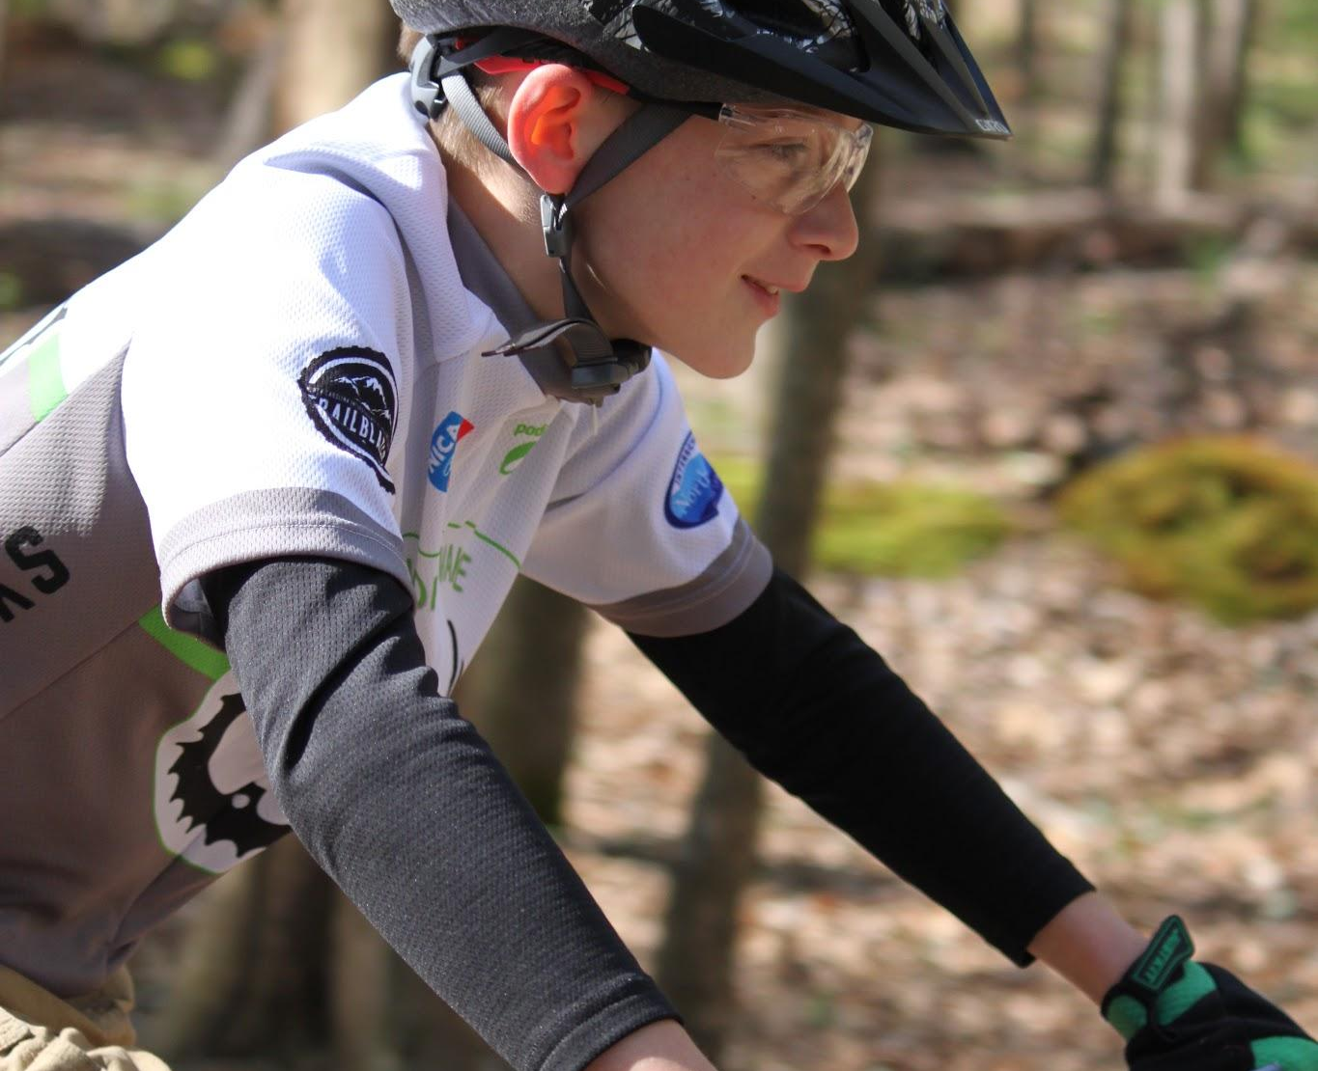
What’s next?
Next steps/how to get involved:
Check out our website at www.marylandmtb.org
Sign up for the Single Track Times newsletter on our website
Let us know your intentions
Follow us & share with friends!
@marylandmtb
PRO TIP: Coaches are the heart and soul of NICA. We need YOU to help us get more kids on bikes!

Slide 14
NICA is about more than riding bikes

Slide 15
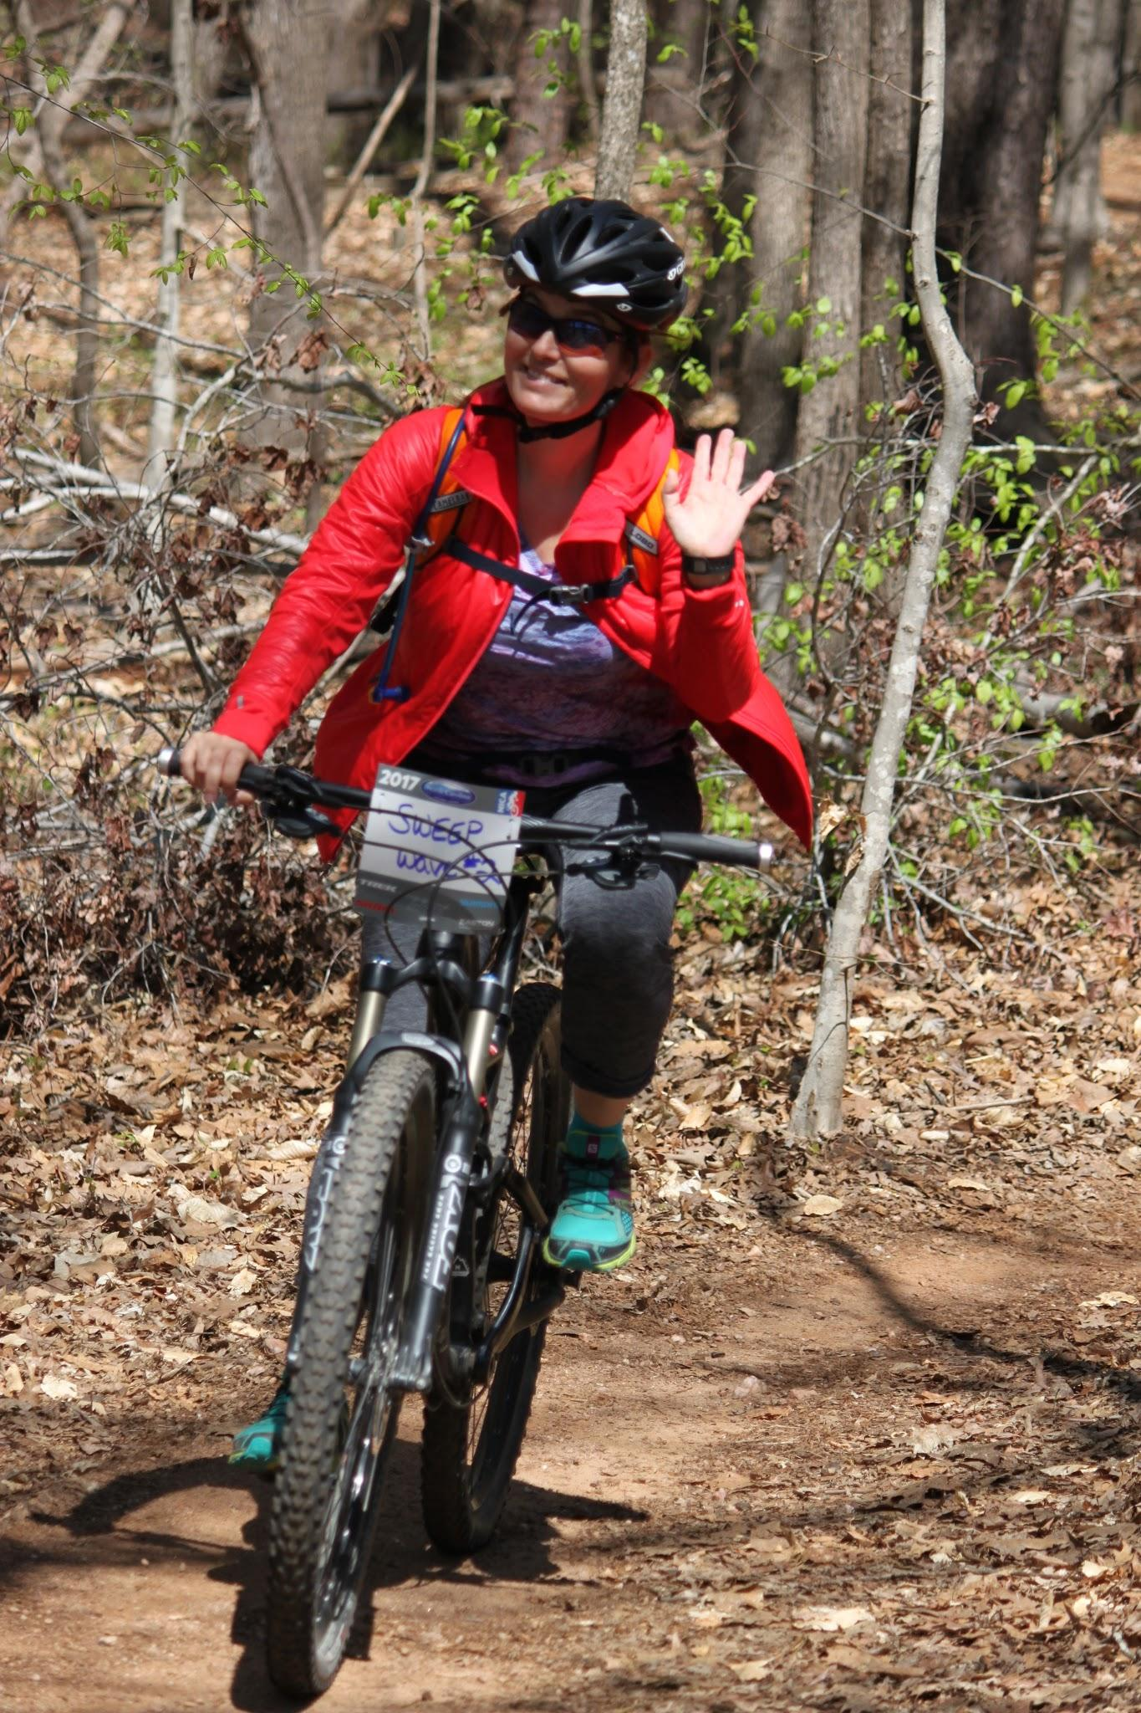
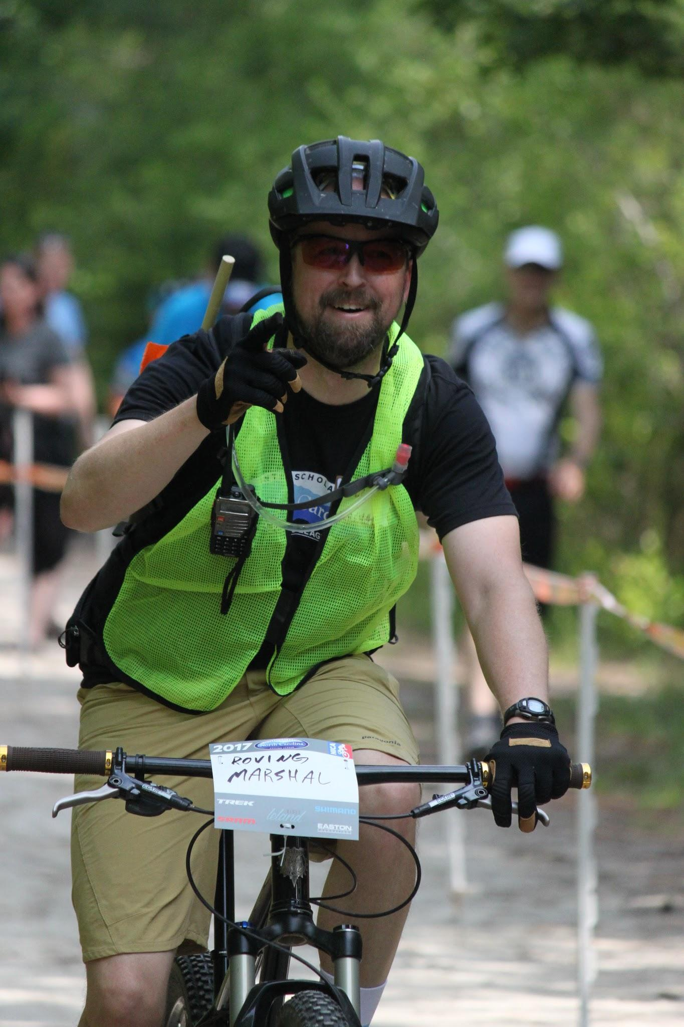
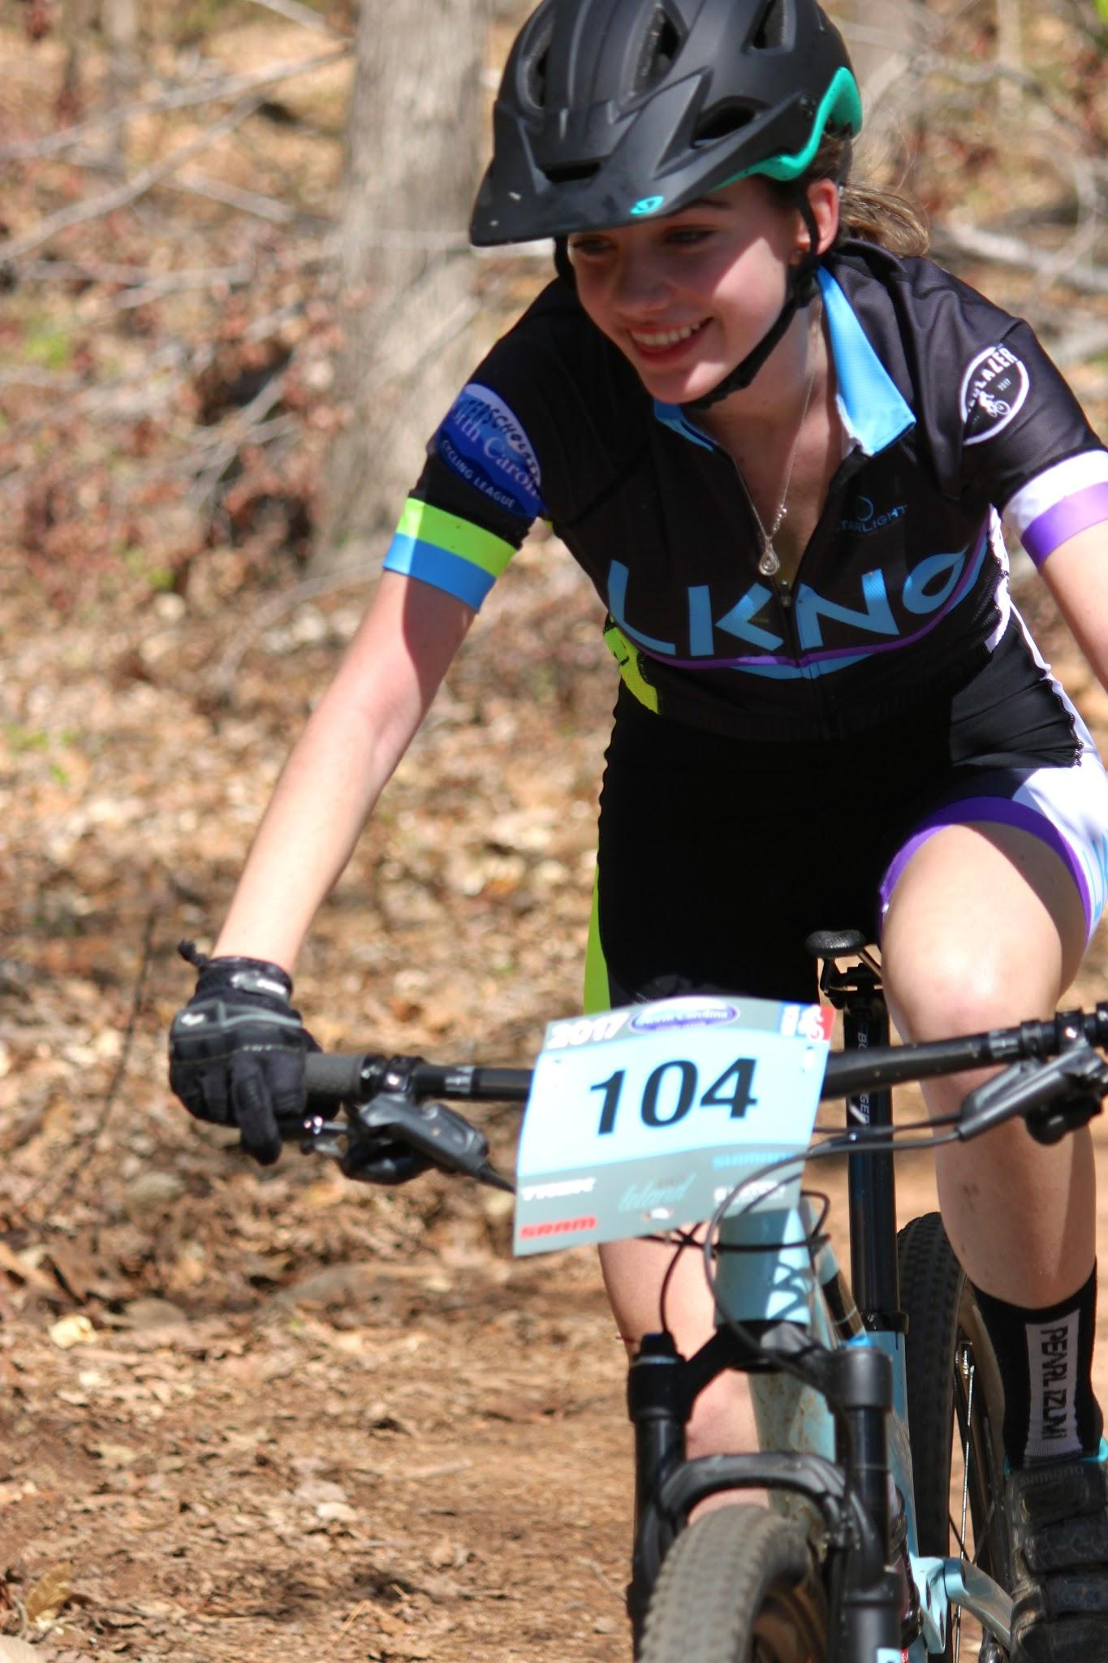
Thank You

