Slide 1
Funding Trail Networks in Maryland
Maryland Bike Summit● Annapolis, Maryland ● February 13, 2018

Slide 2



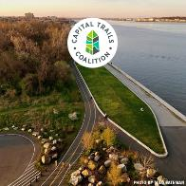
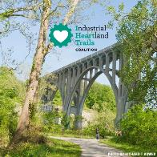

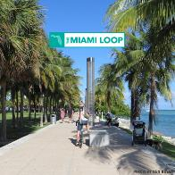
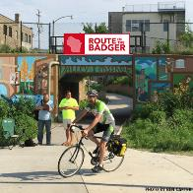
TrailNation
™
Notes:
Provide a 30,000 foot overview here on TrailNation

Slide 3
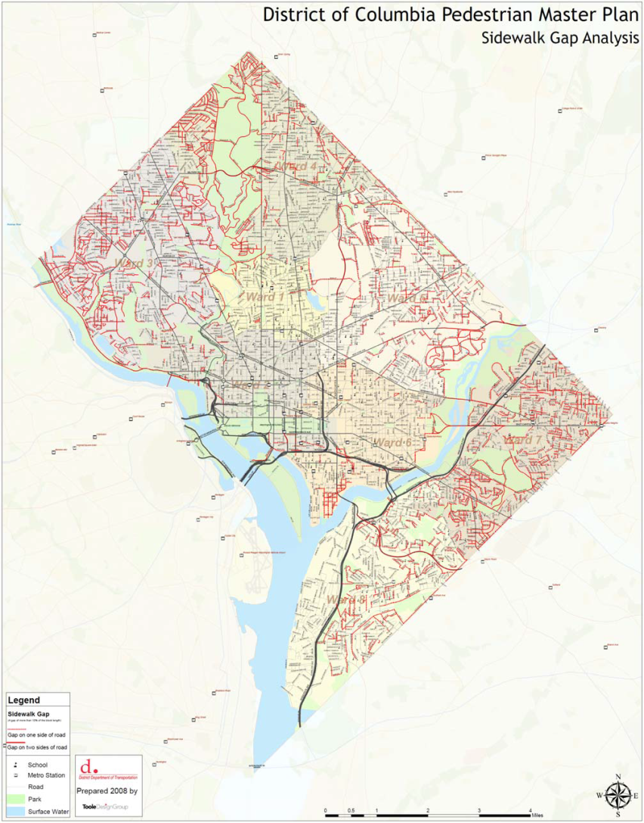
Unfinished Business: Networks
Notes:
KEVIN (4 minutes)
Networks concept & import (slide of trail & sidewalk networks-- scale)

Slide 4
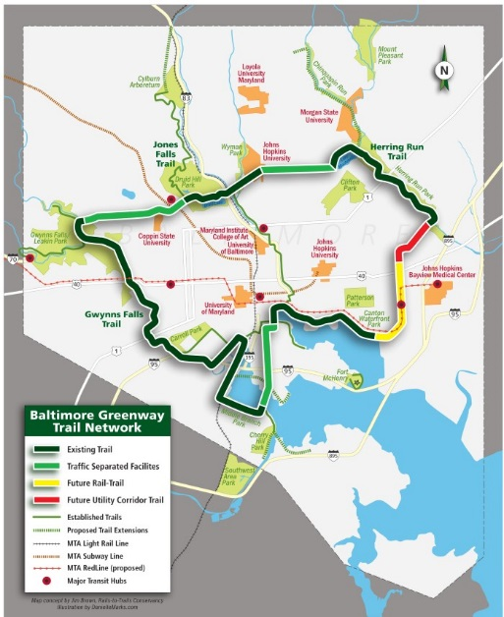
Baltimore Greenway Trails Coalition

Slide 5
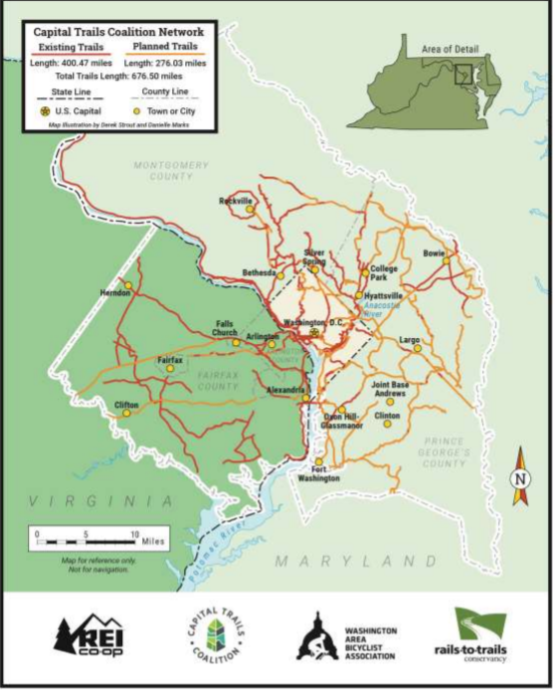
Capital Trails Coalition

Slide 6
Frederick County Bikeways & Trails Plan

Slide 7
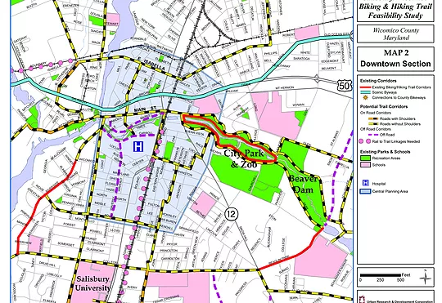
Salisbury/ Wicomico Trail Feasibility Study

Slide 8
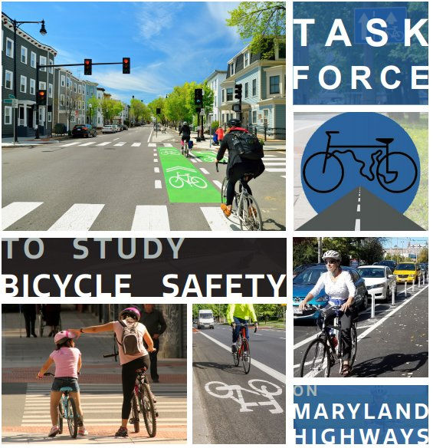
Task Force to Study Bicycle Safety on Maryland Highways
The task force report included several recommendations on funding for bicycle infrastructure, including:
Expanding and consistently funding discretionary programs like MD Bikeways to assist local jurisdictions in increasing bike mode share and improving safety.
Improving administration and utilization of federal funding programs.

Slide 9
Maryland Bikeways Program
Enhancements
Although the Maryland Bikeways program currently does focus on priority areas, the focus on networks could be strengthened:
Prioritize communities that develop and submit network plans with community support;
Utilize metrics to prioritize investment in areas that build connections to activity centers, workplaces, commercial centers, and transit.

Slide 10
Increased Funding
Current bicycle funding sources:
Maryland Bikeways – approximately $3 million this year, proposed for $3.68 million in FY 19.
Maryland Bike Retrofit Program –$2.3 million in FY 18, proposed for $3.6 million in FY 19, focused on SHA right-of-way
Statewide this is minimal – proposal is to nearly double Bikeways to $8 million by 2023.

