Slide 1
2012 University of Maryland LAB Bicycle Friendly University (BFU) Case Study

Slide 2
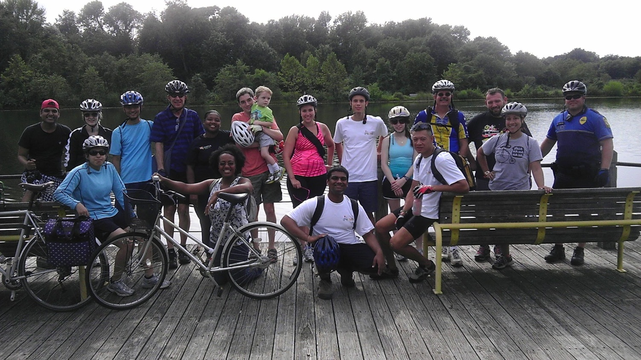
Who are we?
Beverly Malone
Assistant Director at UMD DOTS
MBA, IUB Kelley School of Business
“Ask me about cycling in the snow.”
Valerie Goubeau
Coordinator
BA, UMD School of Music
“Ask me about how many times I have fallen off my bike.”
Lake Artemesia, Berwyn Hts. MD
BTW You will meet Mike at the end.

Slide 3
!!Know your campus!!
Students/F&S
Who are they?
Administration
How do they feel about cyclists?
Funding
Do you have any? How much? Can you get more? When?
Existing Facilities
Do you have any? How much? Can you get more? When?
How do they get to campus?
Why don’t they bike?
Do they think it belongs in the master plan?

Slide 4
UMD 2009
Students/F&S
18- 26, MD and NJ (transit aware)
Administration
This is changing
Funding
Sustainability funds/fuel surcharge
Existing Facilities
Bike shop, tons of racks (not enough), low speed limits, closed campus
Walk, Shuttle-UM, drive
Safety is #1
Do they think it belongs in the master plan? YES!!

Slide 5
What is bikeUMD?
The group
Brand and logo
Campus centric
Collaborative
Resources
Full and part-time Staff
Marketing
Assistant Director level leadership

Slide 6
What does it mean to be a Bicycle Friendly University?

Slide 7
The Five E’s
Engineering
Enforcement
Education
Encouragement
Evaluation

Slide 8
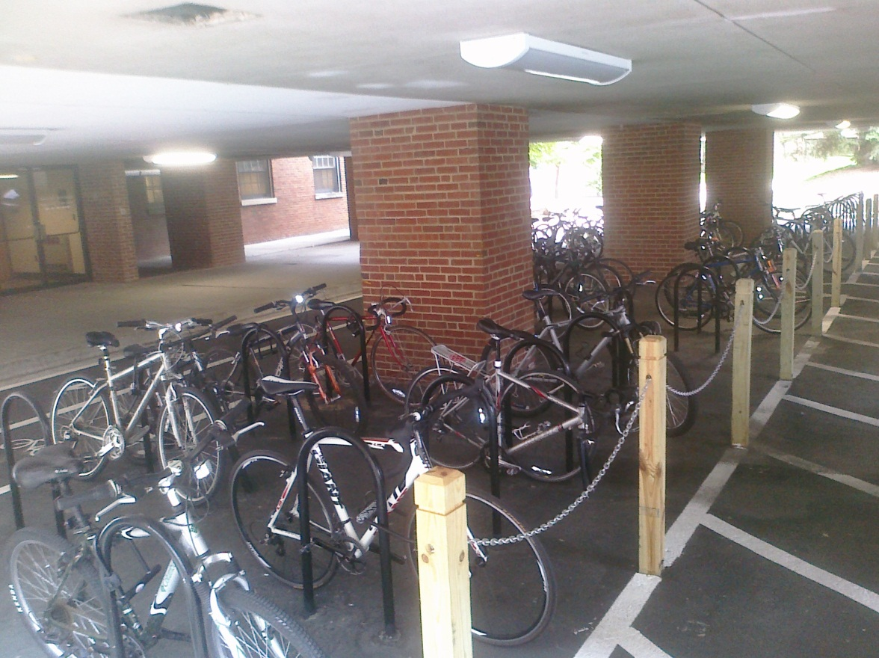
Engineering

Slide 9
Campus Racks 2010 - 2012
4208
Total
Capacity
747
Covered
3450
Uncovered
You can also “park” you bike on Shuttle-UM while you ride. Almost 100% of the fleet has bike racks in front.

Slide 10
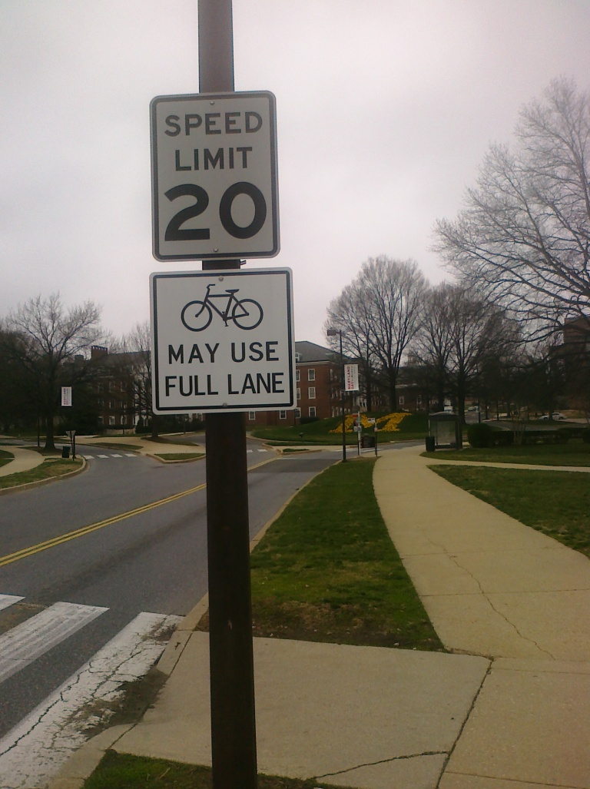
Lanes and Paths
8 Bikes may use full lane signs installed
Biking added to the Facilities Master Plan Update
Shortens the approval process
Supports buy-in

Slide 11
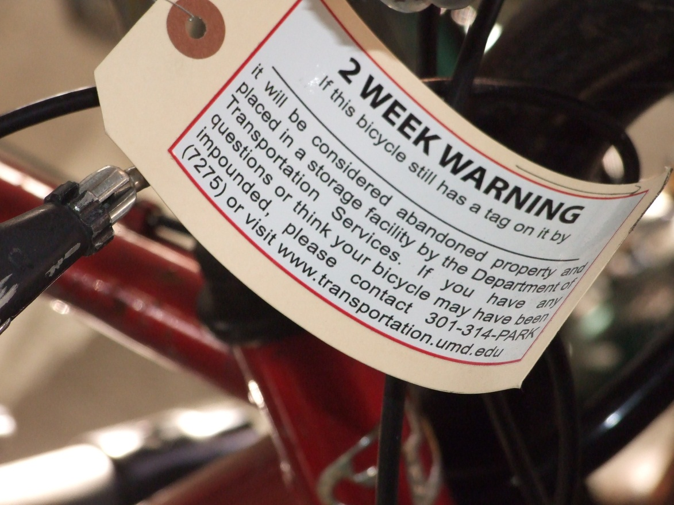
Enforcement

Slide 12
Bike Theft 2010
#of bikes has increased, thefts are down 3%.
Location
Thefts are most likely near residence halls
Awareness
Freshmen may not realize need for U-locks. Some people lock bikes to bushes, etc.
Gear
Many bikes still are not locked with U-Locks
Timing
Most bikes are stolen in the fall with 30% of all thefts occurring in September.
More than 5,000 bikes are estimated to be parked on campus.
In general thefts are considered to be under-reported.

Slide 13
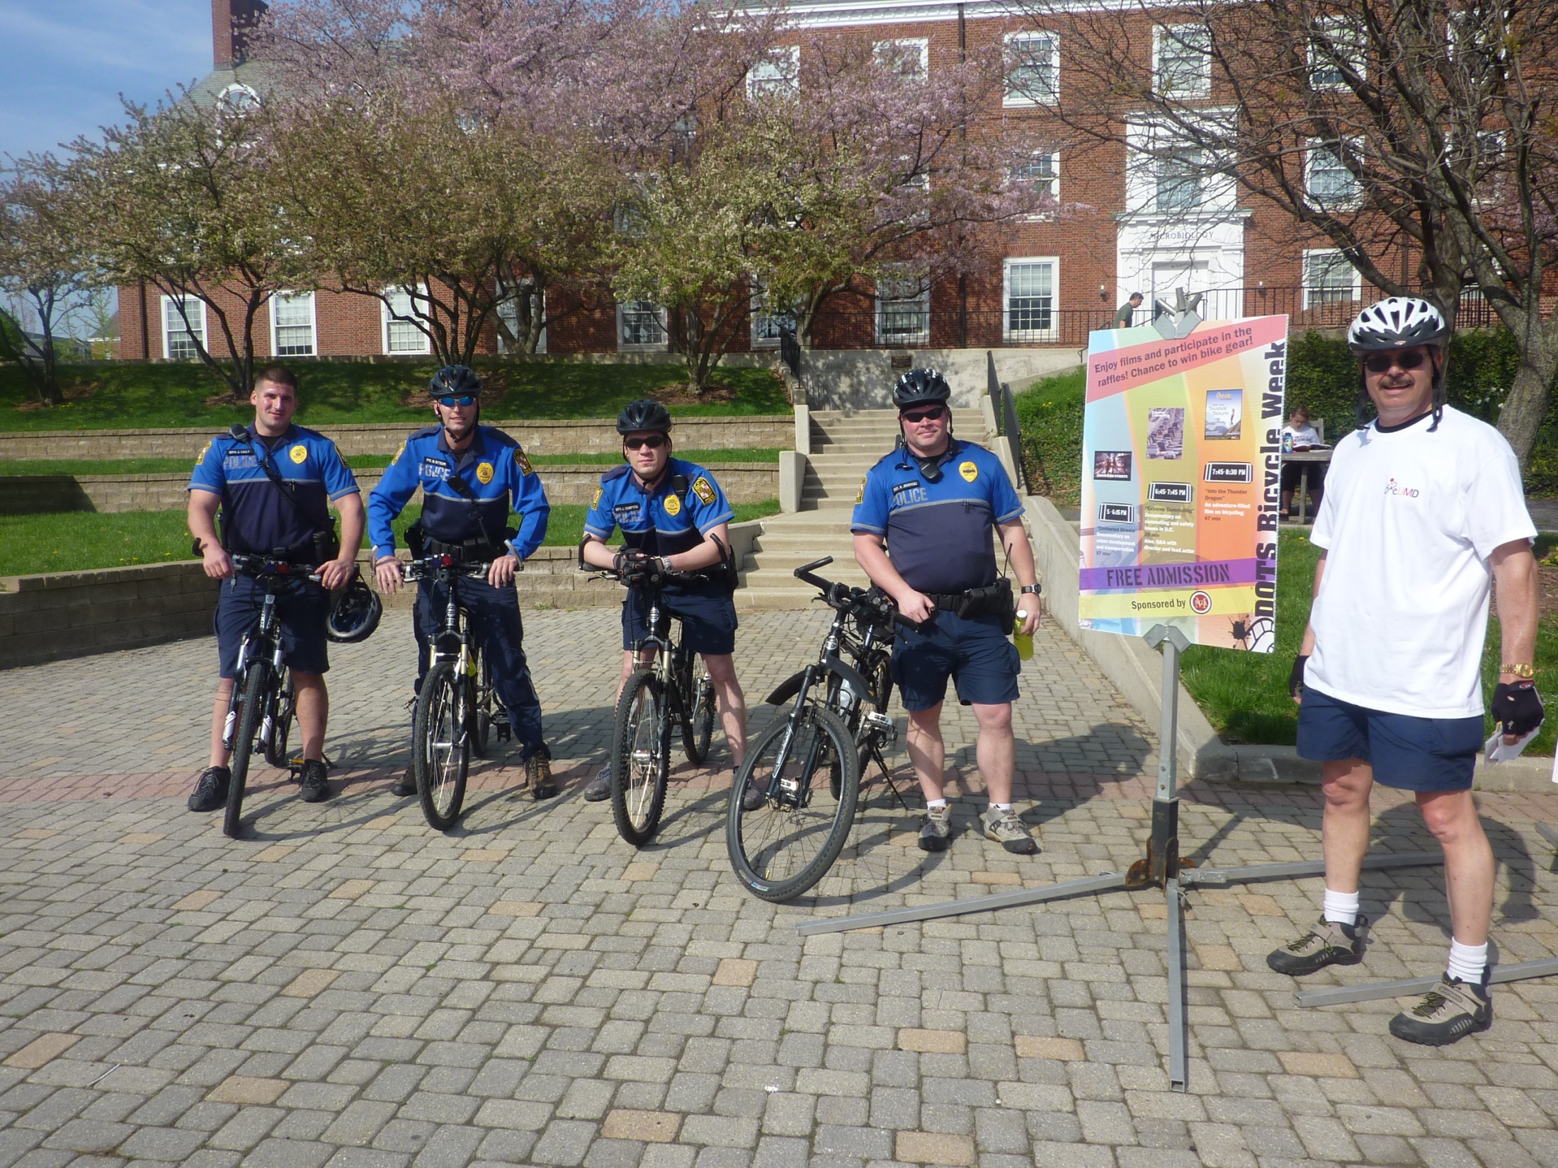
Bicycle Police
14 members of the UMCP force are on bicycles.
UMCP collaborates directly with and supports bikeUMD.
bikeUMD is collaborating with the State of Maryland to develop a training video for police regarding bicycling.
That is John Brandt, our former bike Coordinator. He used to be a Captain for UMCP.

Slide 14
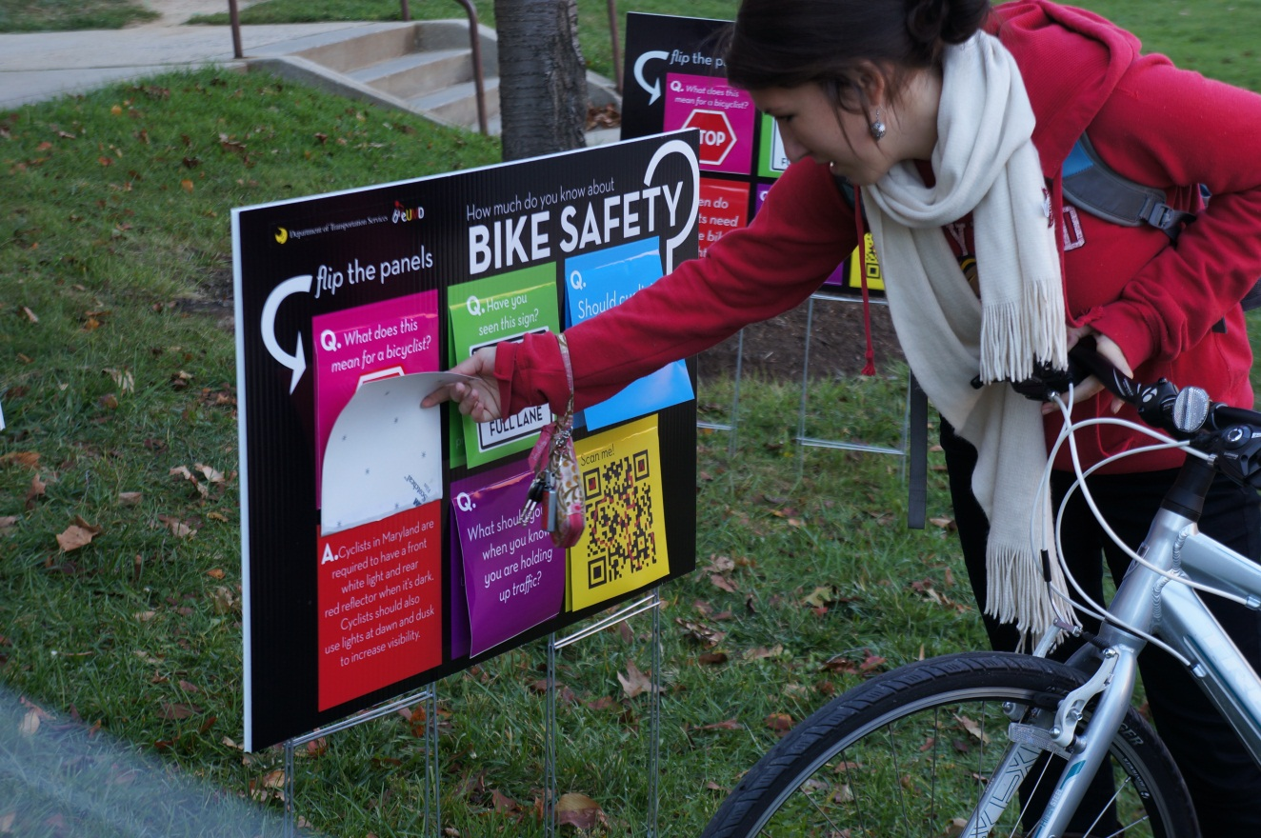
Education

Slide 15
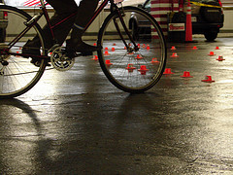
Clinics and Services
Most parents never teach the skills that are presented in these classes and most people learn to ride from their parents.
Bike Shop
BikeUMD/DOTS
Bike Maintenance
Gear Shifting
Slow Speed Maneuvering

Slide 16
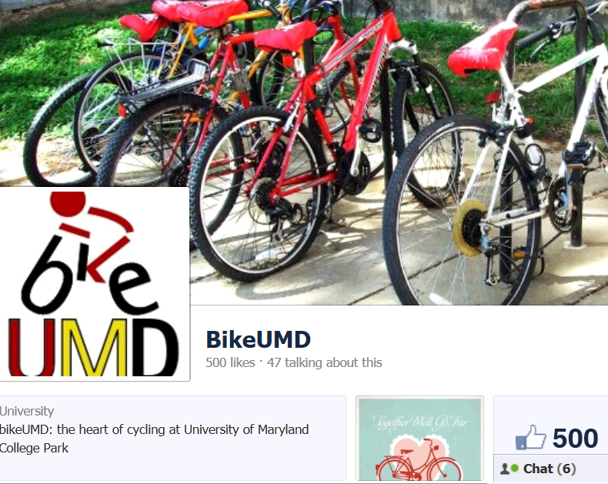
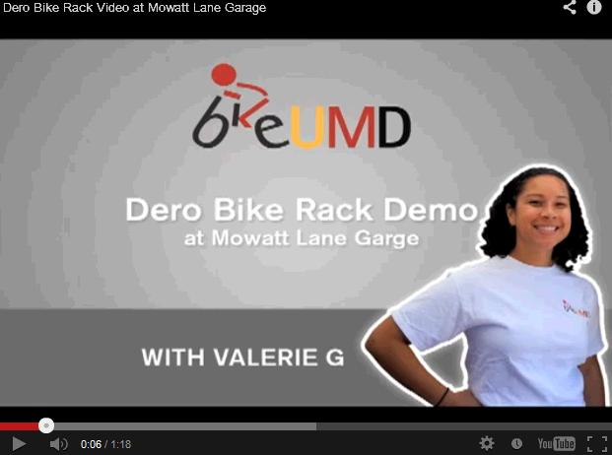
Media Communications
Online – Social Media
Using Racks
Locking bikes
Flyers and Handouts
Maps – campus and beyond
Share the Road messaging
Program Magnets
Flip Charts
Campus specific danger zones
Campus specific commutes
Videos
Customized content
Crash reports- rack requests
Blog

Slide 17
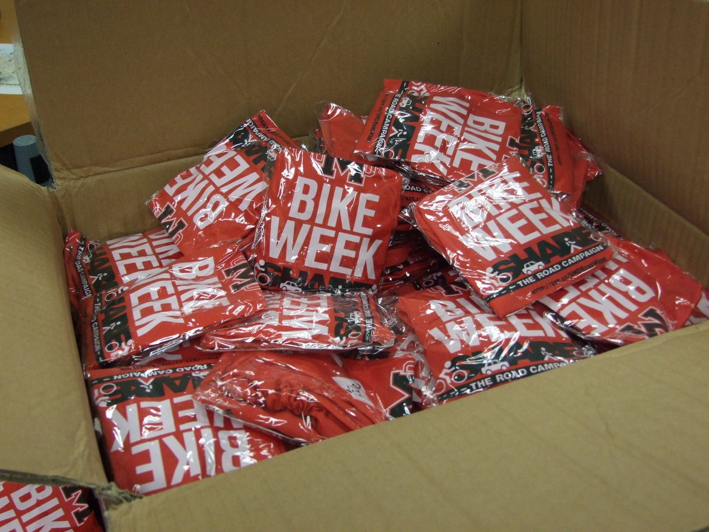
Encouragement

Slide 18
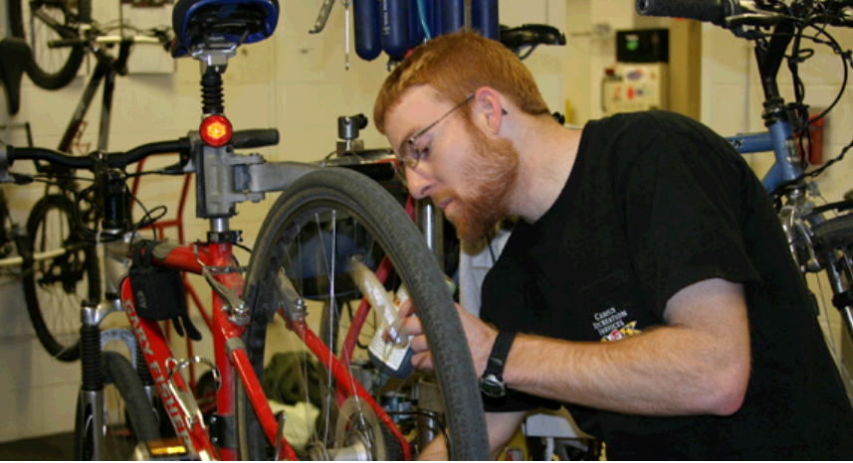
Bike Shop Utilization
Bike Shop usage has increased dramatically. This has lead to an increase in the types of clinics offered.

Slide 19
Bike Rentals
The bicycle lease program is truly collaborative. The equipment is funded by DOTS but the bikes are checked out an maintained by CRS.
Bicycle Lease Program
$70 per semester, includes lock, lights and fenders.
Started with 25 bikes
Currently has 73 bikes
100% utilized
4 departmental programs (faculty and staff)

Slide 20
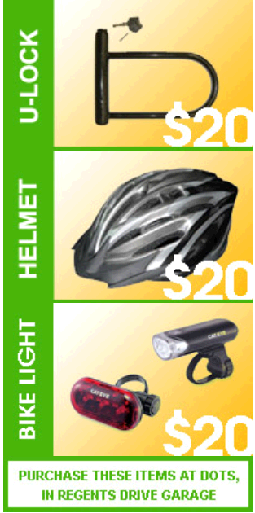
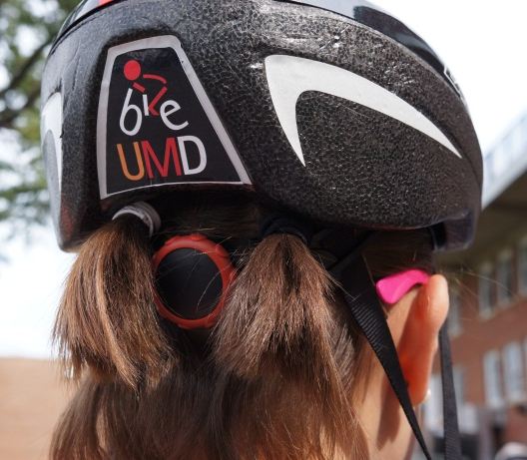
Incentives
Discounts
Lazer Helmets, $20
Giveaways
“Bikes Be Bright” light giveaway
Free U-Lock with bike registration
Bike raffles
U-locks $20
Planet Bike lights, $20

Slide 21
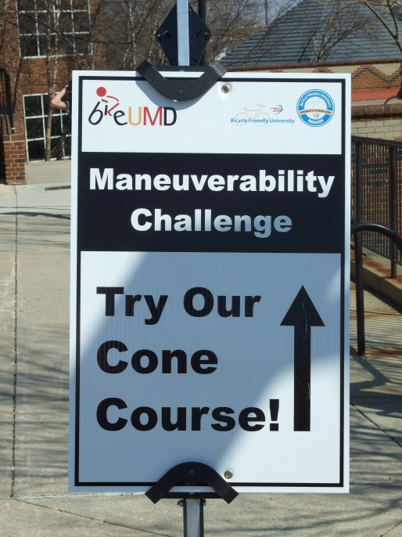
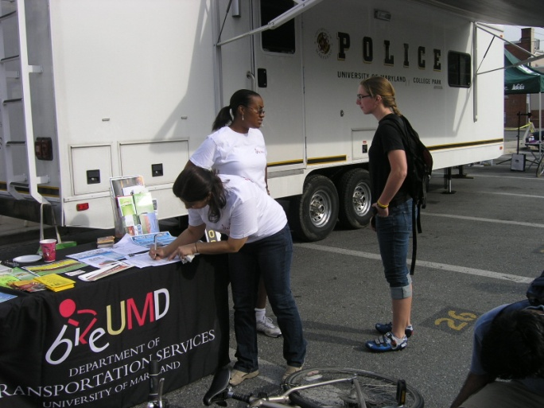
Events
Bike to Work Day
Commuter Challenge/ Car Free Day
Bike Week
Biking Film Festival (2010)

Slide 22
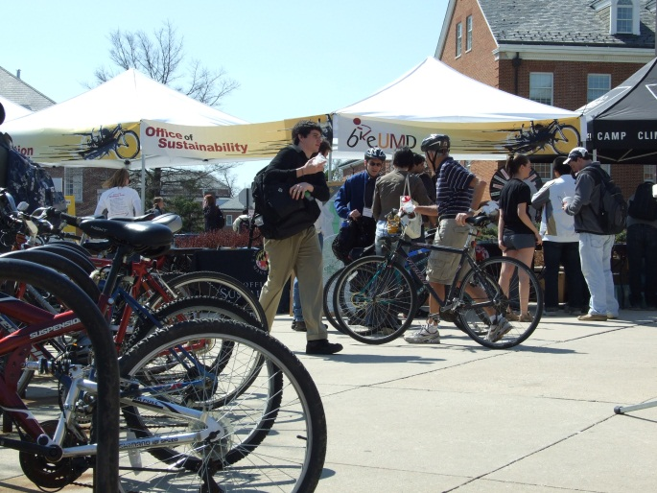
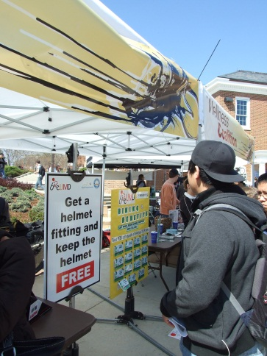
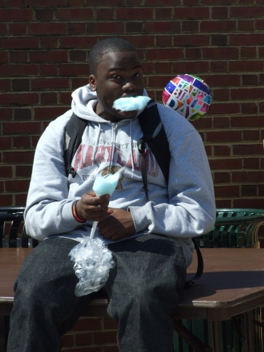
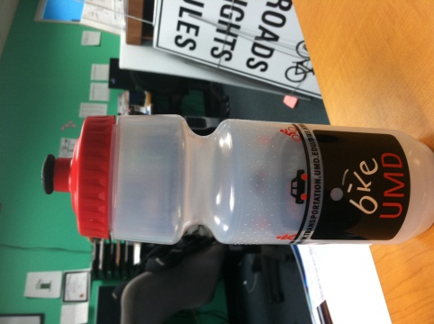
Bike Week
Day of Fair
Info Tables
Helmet fitting and giveaways
All week long:
Rides
Clinics
Mobile mechanic stations
And more!

Slide 23
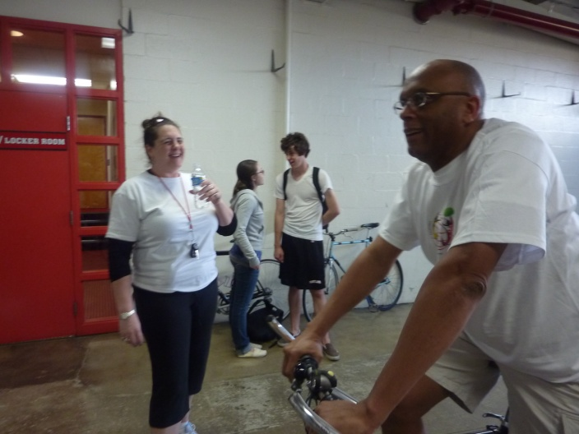
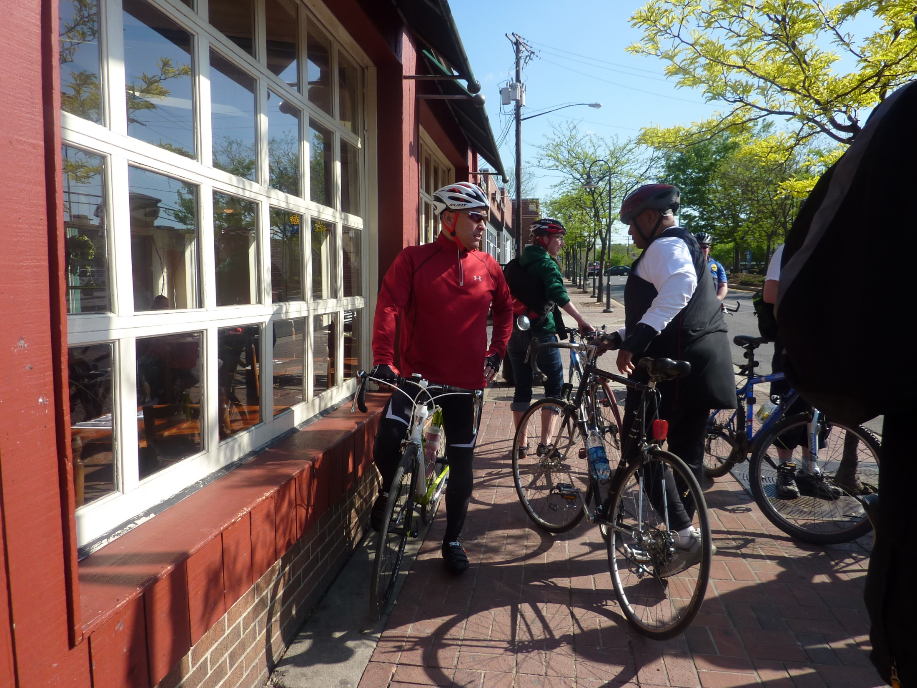
Rides
Social Hours
Trips
Leisure Rides
Biking Lunch and Learn
4 pm rides to Bentley’s, Ledo’s
Lake Artemesia
Shoppers, Home Depot
Trips to local areas and beyond can be created on request by the ORC
David Allen, Director DOTS, ready to ride

Slide 24
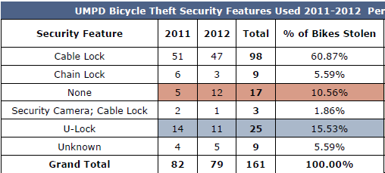
Evaluation

Slide 25
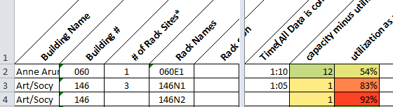
Data Collection
Bike counts
Commuter Surveys
Rack Requests
Crash Reports
Bicycle Theft Data
Bike shop usage data
Fair attendance counts

Slide 26
Bike Coordinator
Mike Levengood
bikes@umd.edu
301 – 314- 7275
Mike started at the University in February of 2012. Previously Mike was the Program Administrator for Safe Routes to School for Frederick County Schools.
Mike is a Nationally Certified League Cycling Instructor who has taught cycling at the college level for a number of years.
Mike has a BA From MSC and a MA from Rowan University. Mike has served on the Governors’ Bicycling Advisory Board and is presently serving on the board of Frederick County Safe Kids.

