Slide 1
MICA Fitness
Aaron Roppolo
Fitness Director

Slide 2
Who are we?
Admin
Fitness Coordinators
Fitness Assistants

Slide 3
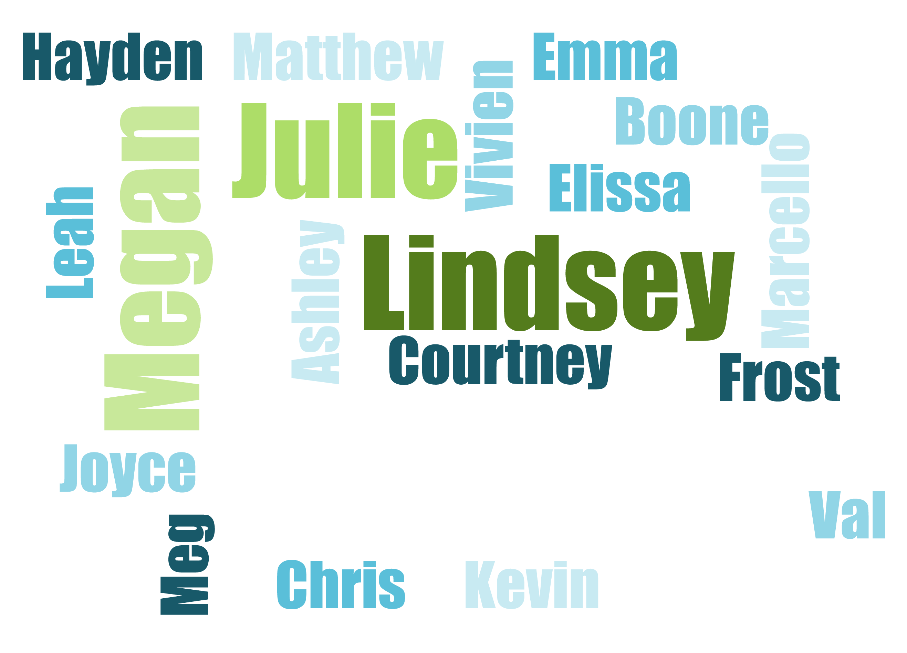

Slide 4
Background
MICA Bike Share
Students of Sustainability
MICA Cycling
“Fred killed the bike lane”
Cycling point person

Slide 5
Programming

Slide 6
Cycling Survey 2012

Slide 7
Participation
Surveys Collected
260
237
Enrolled students
143
Cyclists

Slide 8
Respondents

Slide 9
Frequency

Slide 10
Location

Slide 11
Class Standing

Slide 12
Why they cycle

Slide 13
Injuries
[last 12 months]

Slide 14
Causes of Injury

Slide 15
Safety Practices

Slide 16
Moving Forward
Safety Incentives
MICA Cycling Map
Orientation Programming

Slide 17
Questions? Comments?

