Slide 1

Complete Streets Policy and Implementation
Jason Ridgway
February 11, 2014

Slide 2
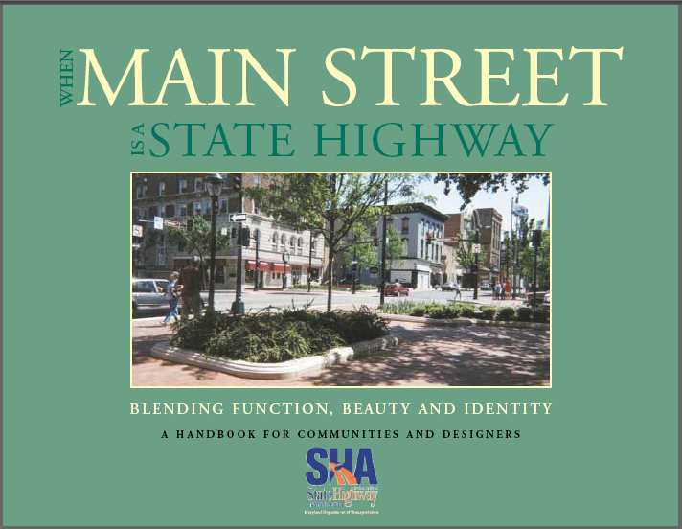
Evolution - The First Decade
  1998 – Thinking Beyond the Pavement
  2000 – Law – TR §2-602
  2000 – Access 2000 transit studies
  2001 – When Main Street is a State Highway
  2003 – Bicycle Design Waivers
  2006 – ADA Policy & Design Guidelines
  2012 – Complete Streets Policy
  2013 – Bicycle Policy & Design Guidelines

Slide 3
Transportation Article § 2-602
The General Assembly finds that it is in the public interest for the State…, and declares that it is the policy of the State that:
(1) …pedestrians and bicycle riders shall be considered and best engineering practices [used] ….;
(2) [State]…maintains an integrated transportation system … [and] remove[s] barriers, …;
(3) …options for pedestrians and bicycle riders will be enhanced and …will not be negatively impacted…
(4) In developing the annual Consolidated Transportation Program, the Department shall:
(i) Ensure that there is an appropriate balance between funding for:
1. Projects that retrofit…for pedestrians and bicycle riders….
2. New highway construction projects; and
(ii) In transit-oriented areas …., place increased emphasis on projects that … increase accessibility for the greatest number of pedestrians and bicycle riders.

Slide 4
Complete Streets Intent
Complete Streets is not a one-size fits all
A good policy should require engineers and planners to think about Complete Streets elements in every project
It should encourage discussion about bike and pedestrian accommodations that goes beyond standards
  All decisions must be a “balanced” approach toward the needs and safety of all roadway users

Slide 5
Complete Streets is about thinking about all of these when developing safe solutions on our roadway system:
Vehicles
Bicyclists
Pedestrians
Transit vehicles and users
Freight movement
ALL working together

Slide 6

Complete Streets Opportunities
MDSHA has focused on design elements for over a decade
Complete Streets applies to more than just PROJECTS
  Projects require a defined scope
  Complete Streets begins during long range planning
  Connecting State and Local goals and across internal programs
  Connecting project outcomes with statewide goals
Complete Streets helps Resolve Competing Needs
  Un-unified goals and values
  Lack of clear measures
    Safety and access for bicyclists
    Accessibility to and reliability of transit
    Convenience of one mode vs. convenience of another
    Freight movement
Source: jpmorganmarketing.com

Slide 7
2012 Complete Streets Policy
“Requires all SHA staff and partners to consider and incorporate Complete Streets criteria for all modes and types of transportation when developing or redeveloping our transportation system”
SHA bike/Ped guidelines must be met unless justified
Recommendations on enhanced bicycle and pedestrian treatments must be considered
Decisions to not provide such enhancements must be justified in milestone reports
Rationale should leverage initiatives
Decisions should be backed with as much data as possible
Notes:
Documentation and Explanation yeilds TRANSPARENCY

Slide 8

Making Progress
Complete Streets Policy (July 31, 2012)
Requires all projects to include Complete Streets justifications
  Explanations why accommodations can not be provided
  Data driven approach using available tools
  Projects use multi-modal level of service analysis to justify need or lack there-of
Will evaluate and improve policies and programs that may have shortfalls in reaching a complete street goal
Has encouraged more in-depth discussions at project meetings about bike and ped accommodations
Notes:
Bicycle and Pedestrian initiatives expected to be complete in 2012

Slide 9
Evolving Practices
Balancing competing needs
  Storm-water management needs
  Traffic capacity needs
Balancing the needs of local community vs. the overall transportation system
Review SHA and federal guidelines to ensure we are maximizing Complete Streets
Coordinating our multitude of programs and initiatives to be more effective
Notes:
Balancing Competing Needs – US 40 Pulaski Highway and Storm Water Management
Traffic Capacity – We may be able to accept lower LOS on the roadway
Balancing Needs of Community – BRT in Montgomery County
Coordinate our Programs – Looking at ways in which our different funds can work together to help with bike/ped initiatives. Ex: Ped Safety Program
Review Guidelines– Signal Warrants – 300 ft min spacing in MUTCD (engineers think more). Future projection of pedestrian counts and access to facilities may be considered – MD 97

Slide 10
Review of Guidelines
Staff and Management are discussing issues that go beyond just meeting engineering standards
  If there is no right-of-way for a bicycle facility, can we accommodate bikes safely on a parallel access road or a nearby road within the network?
  Where should we provide enhanced bike/ped facilities and target resources accordingly so we get the biggest bang for our buck?

Slide 11
Coordinating Our Initiatives
ADA Policy and Design Guidelines
SHA Bicycle Policy and Guidelines
Twenty Year Bicycle & Pedestrian Master Plan (released Jan 2014)
Redevelopment of Statewide Bicycle Routes
Bicycle and Pedestrian Priority Areas (BPPAs)
Transit Orient Development
Pedestrian Safety KPA
Bicycle and Pedestrian Safety Campaign
New Bicycle Maps and Mobile Applications
Freight Strategic Plan

Slide 12
Making Progress 1st policy SHA Bicycle Policy and Guidelines
New Bicycle and Pedestrian Guidelines
Adopts most of AASHTO 2012 Guidelines to SHA projects
Key Improvements:
Requires bike accommodations on all possible roadways not just a bike compatible shoulder
Places emphasis on accommodating bikes through conflict zones
Requires larger bike lanes than previous policy
Requires some other form of mitigation if bike lanes are not possible
  Sharrows (for outside lane widths between 13 and 15 feet)
  “Bikes May Use Full Lane” for outside lanes less than 13 feet
Notes:
Bicycle and Pedestrian initiatives expected to be complete in 2012

Slide 13
Has it made a difference, its in the numbers

Slide 14
Bicycle Infrastructure
Improved directional miles for bicycles
  57.9 in FY 2012
  66.8 in FY 2013
16.95% increase in miles of bicycle lanes in FY 2013
1.2% increase in miles of shared-use paths in FY 2013
81% of SHA roads are at BLOC D or better
Notes:
All measures are recorded in SHA’s Business Plan.
Business Plan has been updated in 2011 and will begin to report new measures in 2012. New measures ill include:
-number of bike lane miles
-number of shared use path miles
-% of sidewalk gaps filled
-key connections made for bicycles

Slide 15
Bicycle Safety
Notes:
All measures are recorded in SHA’s Business Plan.
Business Plan has been updated in 2011 and will begin to report new measures in 2012. New measures ill include:
-number of bike lane miles
-number of shared use path miles
-% of sidewalk gaps filled
-key connections made for bicycles

Slide 16
Expenditures Overview
Trend = SHA Bike/Ped Programs are increasing in spending by both % of program and Total $
Notes:
Overall Funding for Bike/Ped Programs is over 3.5%. It was at about 5.5% if you include Fund 84 (Community Safety and Enhancements)
This does not include other major projects that have constructed bike lanes and or wide shoulders.
Legend:
Orange Line = Overall SHA Surface Transportation Budget in $
Red = Non-Capital Projects (Bike Retrofit, Sidewalk Retrofit, TEP, etc) in % of Overall Budget
Blue = With Capital Projects including Fund 83 and 84 (Streetscapes and Urban Reconstruction) as % of Overall Budget

Slide 17
Moving Forward
Evaluate SHA’s Complete Streets-related policies and look for gaps in the way we do business
  Establish performance measures
Tailor the programs at SHA to ingrain Complete Streets into all aspects of business
  Criteria for prioritization in programs
  Training engineers and planners
Determine a more holistic, agency-wide approach to adopting Complete Streets

Slide 18
Questions?
http://www.roads.maryland.gov/OPPEN/SHA_Complete_Street_Policy.pdf
Jason Ridgway
Director of Highway Development
Maryland State Highway Administration
410-545-8800
jridgway@sha.state.md.us

