Slide 1
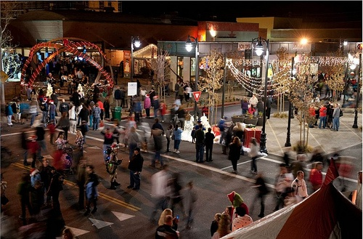
Moving from policy adoption to implementation:
National lessons in Complete Streets
Laura Searfoss
National Complete Streets Coalition
Bike Maryland Annual Bicycle Symposium
Annapolis, MD
February 11, 2014

Slide 2

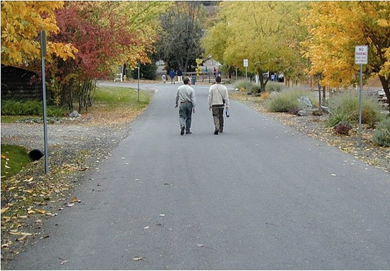
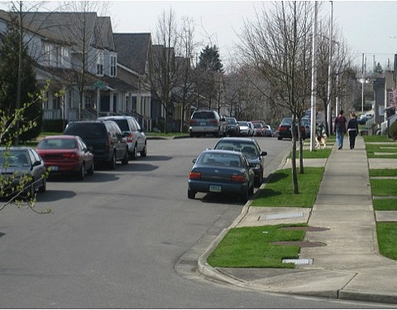
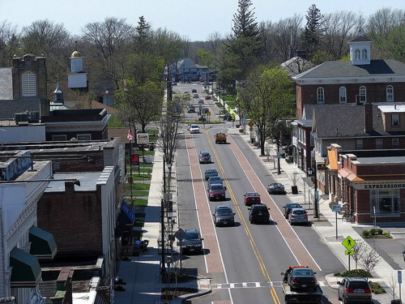
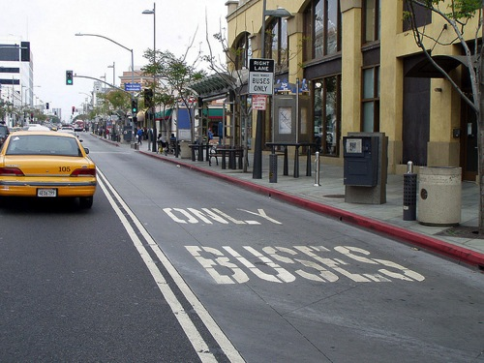
Which is the Complete Street?
[Defining Complete Streets]
Notes:
Complete Streets transform a community’s roads to create safer, inviting, and accessible places. They often require changes in the day-to-day decisions that address road maintenance and construction.

Slide 3
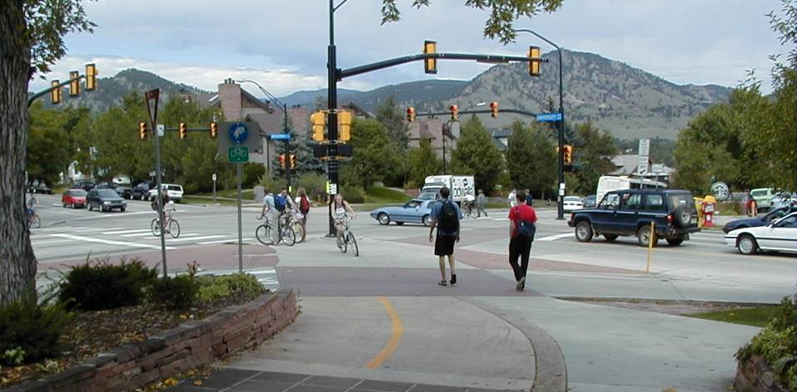
Complete Streets is…
a policy approach
a change to the everyday decision-making processes and systems
long-term changes to built environment
[Defining Complete Streets]

Slide 4
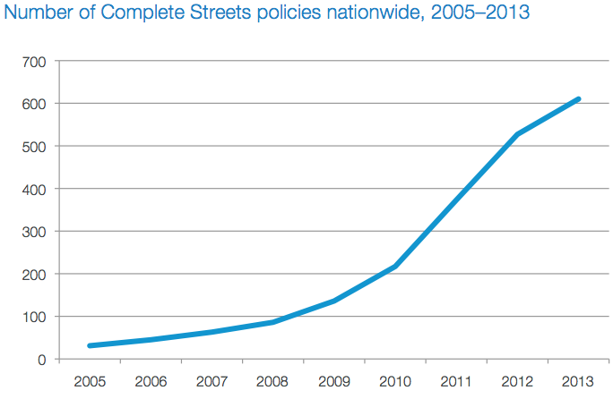
Baltimore
Montgomery County
Prince George’s County
Rockville
State of Maryland
[Policy adoption]
Notes:
Policy adoption has grown to more than 500 policies---ranging from internal design guidance to state-level legislation. More than one-third of all policies were adopted in suburban communities of fewer than 30,000 residents.
Small towns, often in rural areas, are well-represented: Approximately one in five of all Complete Streets policies were adopted in these jurisdictions.
States: 29
MPOs: 42
Counties: 41
Cities: 286
Sets a vision
Specifies all users
Applies to all projects, agencies, and roads
Accommodates exceptions
Creates a network
Sets design criteria
Responds to community context
Defines performance measures
Outlines next steps for implementation

Slide 5
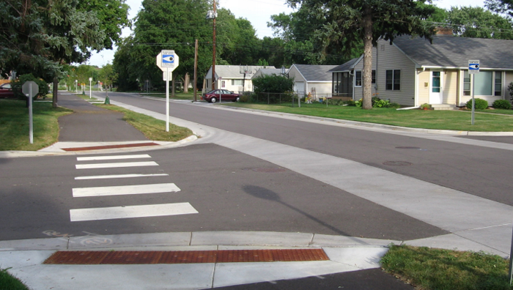
[76th Street, Richfield, MN]
Moving from policy adoption to implementation
Lesson #1. Cultivate political will & community support (again).
Notes:
Communities often lose momentum that drove policy adoption as professionals consider how best to implement their new policies. After examining communities across the United States, the Coalition---in consultation with its Partners through at the United States at the state and local levels---recommends focusing on four steps for effective implementation.
Planning for implementation:
Build relationships between agencies and stakeholders such as public health, law enforcement, and businesses.
Having a champion is invaluable; designate a lead person, agency, and/or committee that will move the process forward.
Formal advisory committees can be an effective catalyst for achieving other implementation steps.
Restructuring procedures, policies, and programs:
Encourage stronger relationships between departments, with citizens, and with elected officials. Try easier, smaller projects or those with obvious, visible benefits first. Keep a network approach in mind when selecting the first projects. New facilities won’t be well used if they don’t connect to destinations or other routes. Document results of early projects, including before-and-after studies of safety benefits if possible
Rewriting or updating design guidance:
Consider making simple changes to design standards, or adopting templates such as the Model Design Manual for Living Streets or Complete Streets, Complete Networks.
Take advantage of mill and overlay/repaving projects by planning, and even designing, ahead of time to include bicycle and walking needs in the process.
Evaluate budgets to support maintenance needs, especially with roadway striping.
Add an evaluation of bicycle and walking needs to the maintenance and operations review cycle.
Offer training opportunities:
Community engineers and planners must hear from their professional peers.
Strive to instill a sense that Complete Streets is part of everyone’s job.
Outreach to community members is an on-going process and must not end with a policy’s adoption.
The first projects are the hardest to sell. Communicate on a project-by-project scale as well as in more general terms. Go to the public so they hear about the project and your goals directly from you first.
Start with temporary or pilot projects, or choose projects with relatively simple implementation; be sure to tie these projects back to the Complete Streets objective.
Provide regular updates to community and agency elected officials and media on implementation and successes.
Ask your Metropolitan Planning Organization to provide training for its member jurisdictions.
Share project successes in the context of overall policy implementation.
Create new performance measures:
Transportation departments should not be the only ones to track performance. They can collaborate with others to collect and analyze data, including the health department and public health organizations; law enforcement agencies and emergency responders; and advocacy groups, including those focused on equity.
Use rates, rather than straight numbers, to show changes in safety and mode shift over time.
Establish baseline data so as to better illustrate successes.
Be clear about measuring outputs (such as blocks of sidewalks built or repaired) versus outcomes (such as increases in walking rates).
Create metrics that are specific to community goals.

Slide 6
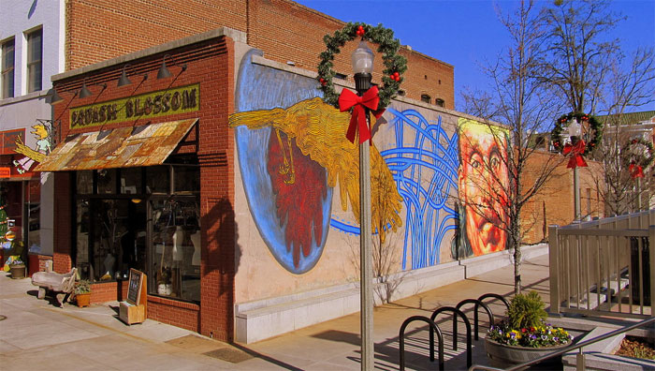
[Ponce de Leon Avenue, Decatur, GA]
Moving from policy adoption to implementation
Lesson #2. Set a clear path for implementation.

Slide 7
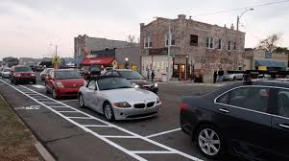
[Broad Avenue, Memphis, TN]
Moving from policy adoption to implementation
Lesson #3. Create ownership within the DOT (or similar agency).

Slide 8
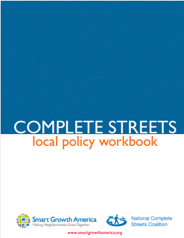
Resources
Fact sheets, photos, handouts
Information on changing policy
Model policy language
Complete Streets blog & monthly newsletter
Links to research & publications
Workshop descriptions
Notes:
Our website is home to many resources, including fact sheets, policy tracking and examples, information on changing policy from advocacy to implementation, links to research and publications, and information on our workshop program.
Local Policy Workbook
Detailed discussion of & questions to ask at each step in developing a policy
Right type of policy
Understanding current process
All 10 elements of ideal policy
Planning for implementation
Work with other stakeholders to answer questions, write language
Draw from best practices, develop best language for your community
Recently added a great implementation page with resources from successful localities for each step.
From our website, you’ll also find a sign-up to our newsletter, as well as blog and Twitter feed, which are great ways to stay up to date on complete streets and transportation issues in general.

Slide 9
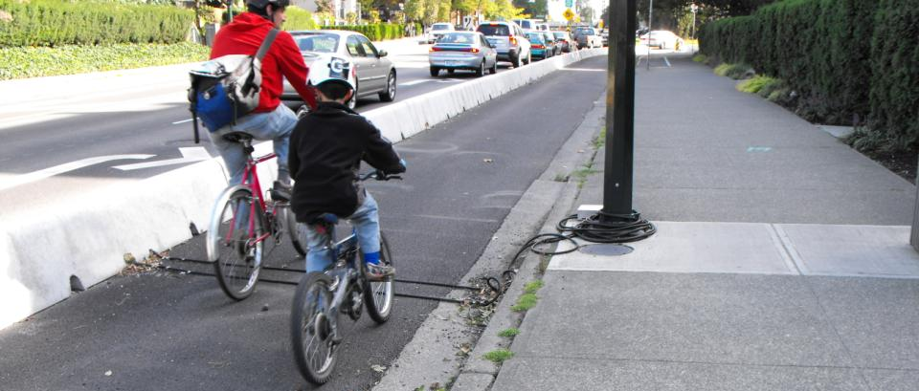
Thank you!
Laura Searfoss
lsearfoss@completestreets.org
www.smartgrowthamerica.org/completestreets
e.
web.

